Slide 1
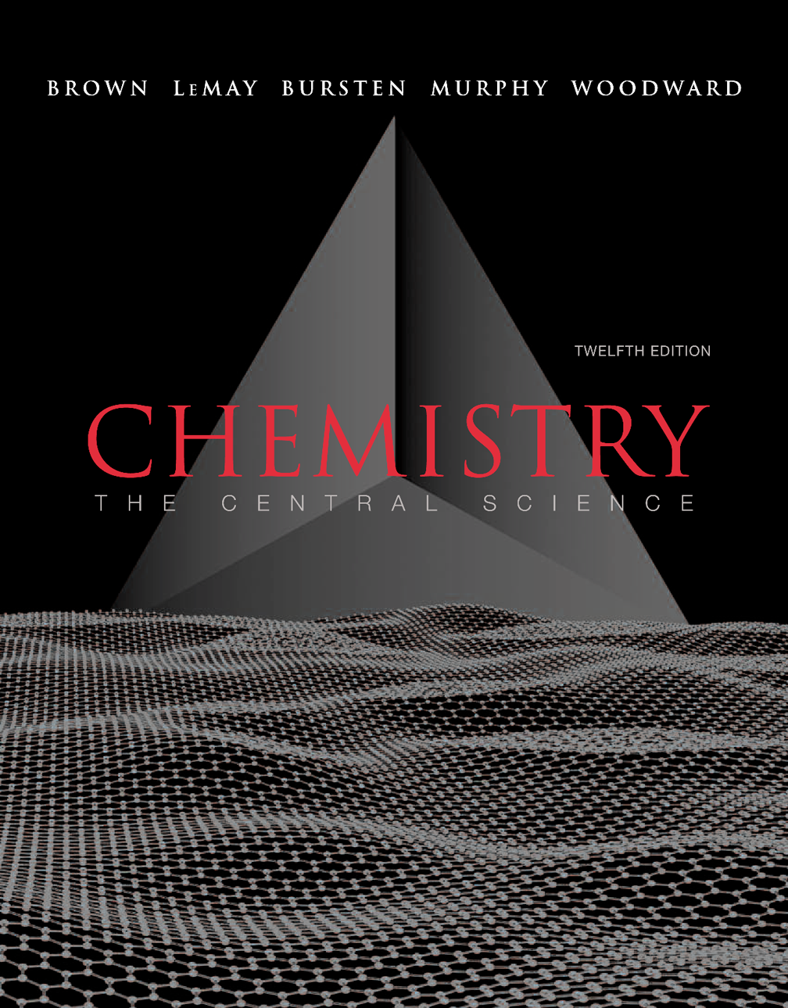
Lecture Presentation
Chapter 12 Solids and Modern Materials
John D. Bookstaver
St. Charles Community College
Cottleville, MO

Slide 2
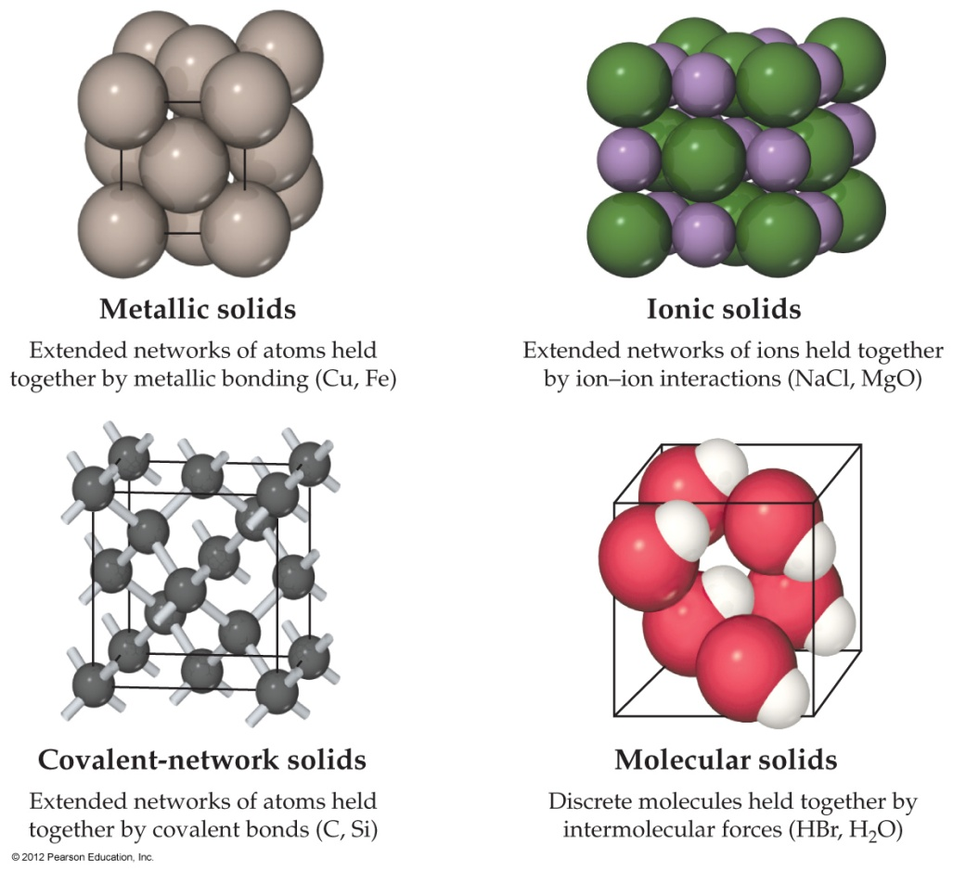
Bonding in Solids
There are four general types of solids.
Metallic solids share a network of highly delocalized electrons.
Ionic solids are sets of cations and anions mutually attracted to one another.

Slide 3
Bonding in Solids
Covalent-network solids are joined by an extensive network of covalent bonds.
Molecular solids are discrete molecules that are linked to one another only by van der Waals forces.

Slide 4
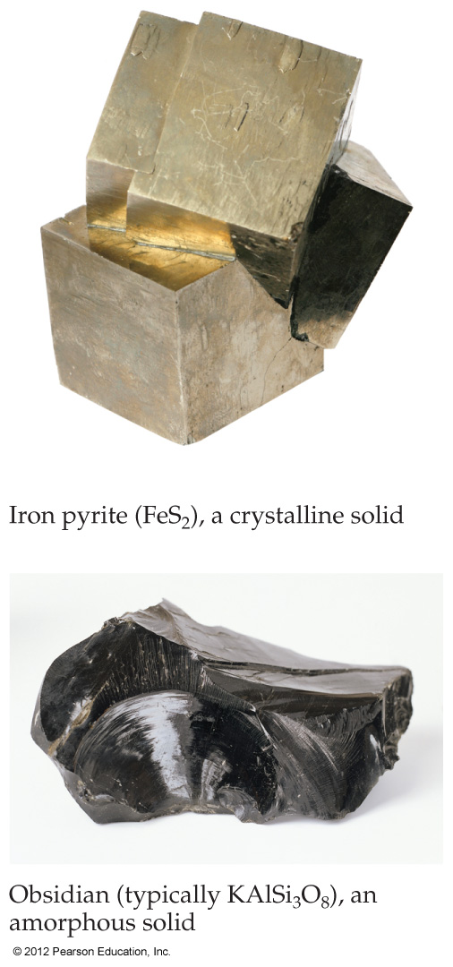
Bonding in Solids
In crystalline solids atoms are arranged in a very regular pattern.
Amorphous solids are characterized by a distinct lack of order in the arrangement of atoms.

Slide 5
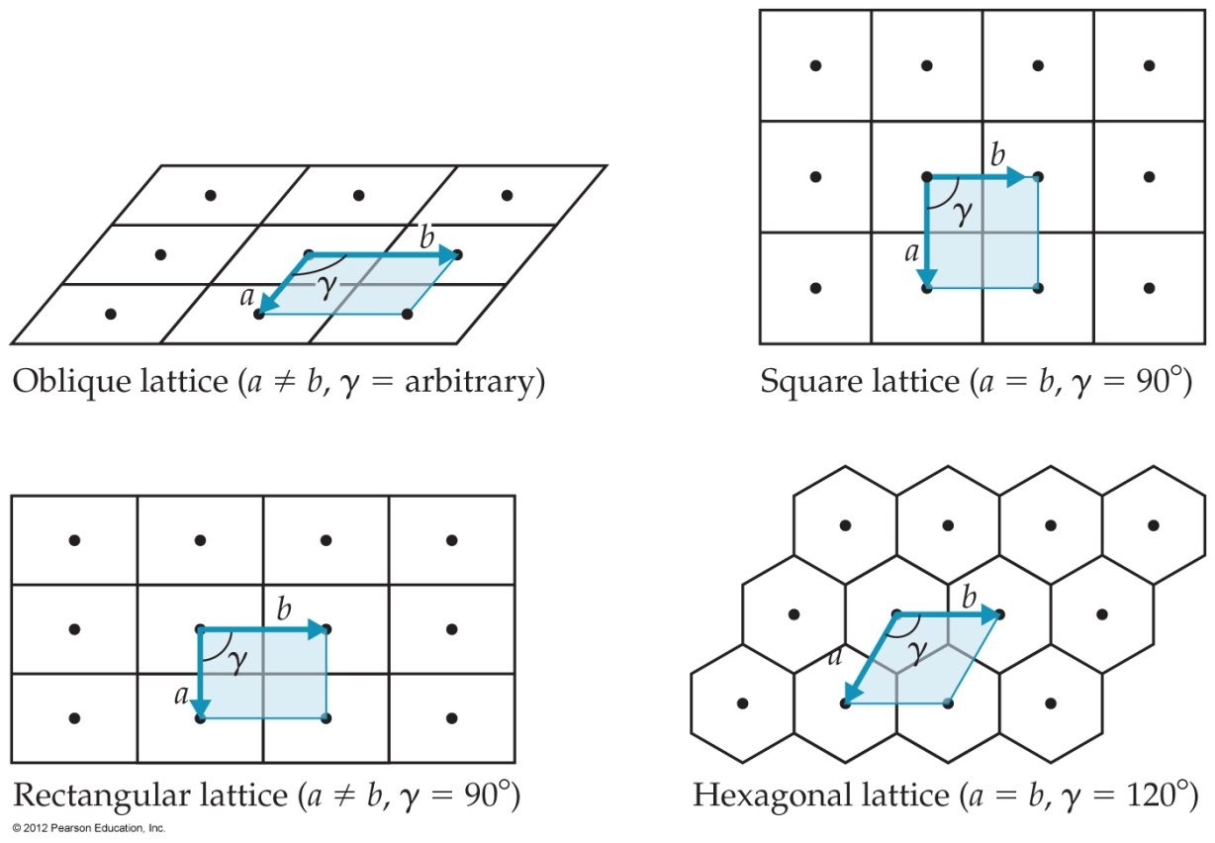
Crystal Lattices
One can deduce the pattern in a crystalline solid by thinking of the substance as a lattice of repeating shapes formed by the atoms in the crystal.

Slide 6
Crystal Lattices
The individual shapes of the lattice, then, form "tiles," or unit cells, that must fill the entire space of the substance.

Slide 7
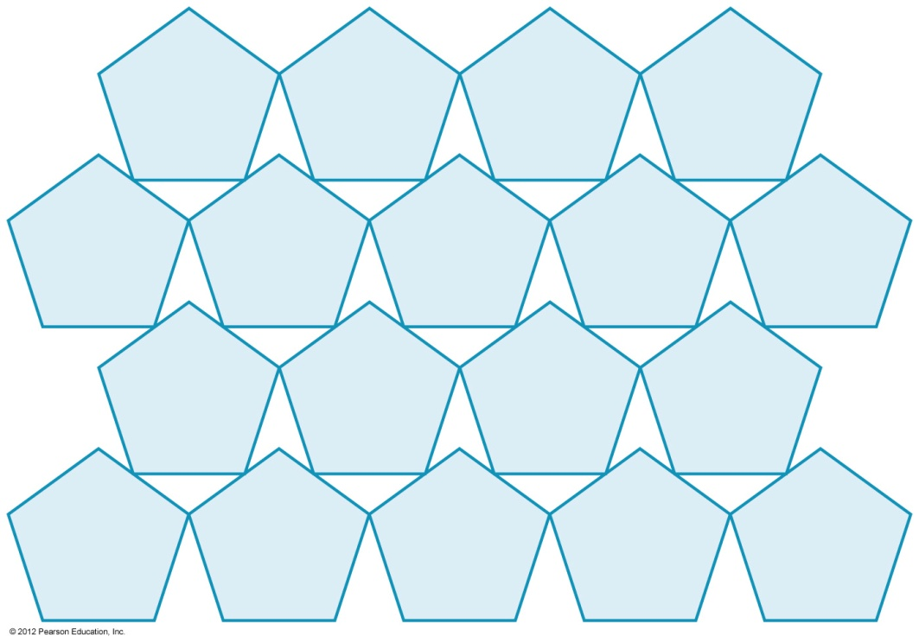
Crystal Lattices
There are seven basic three-dimensional lattices:
Cubic
Tetragonal
Orthorhombic
Rhombohedral
Hexagonal
Monoclinic
Triclinic

Slide 8
Crystal Lattices
Within each major lattice type, additional types are generated by placing lattice points in the center of the unit cell or on the faces of the unit cell.

Slide 9
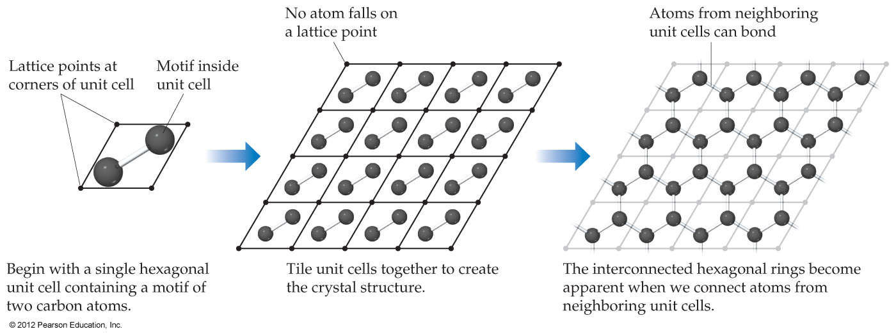
Crystal Lattices
Once one places atoms within a unit cell, the structure of the compound can be seen by bonding the atoms to one another across unit cells.

Slide 10
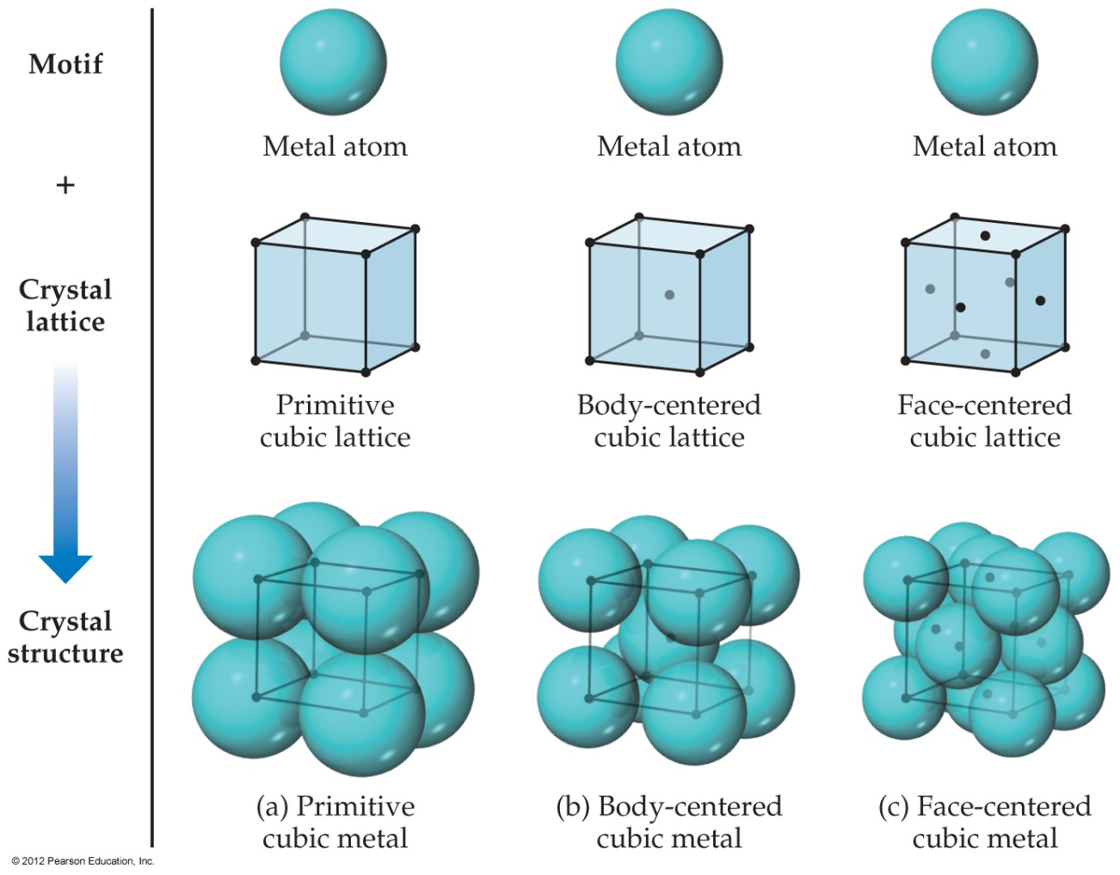
Metallic Structure
The structures of many metals conform to one of the cubic unit cells.

Slide 11
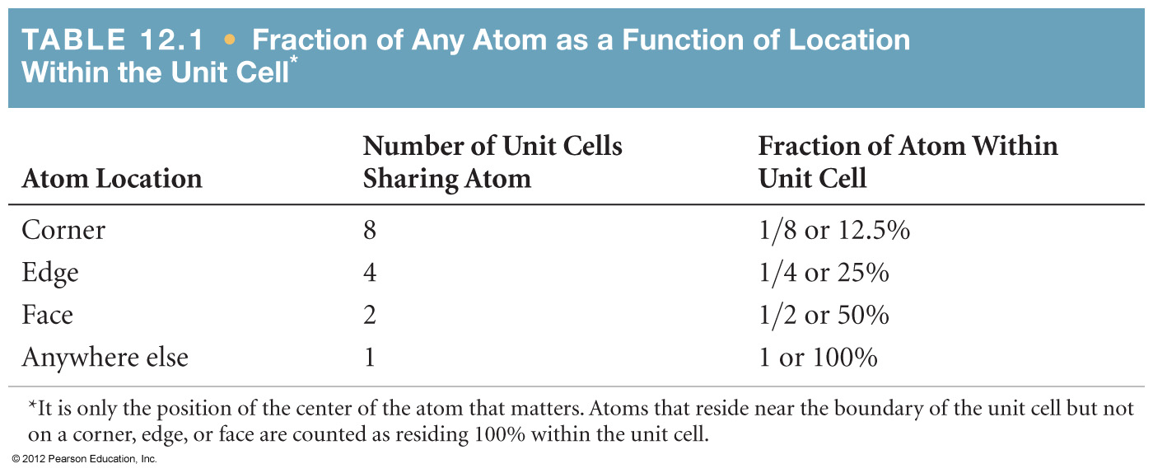
Cubic Structures
One can determine how many atoms are within each unit cell which lattice points the atoms occupy.

Slide 12
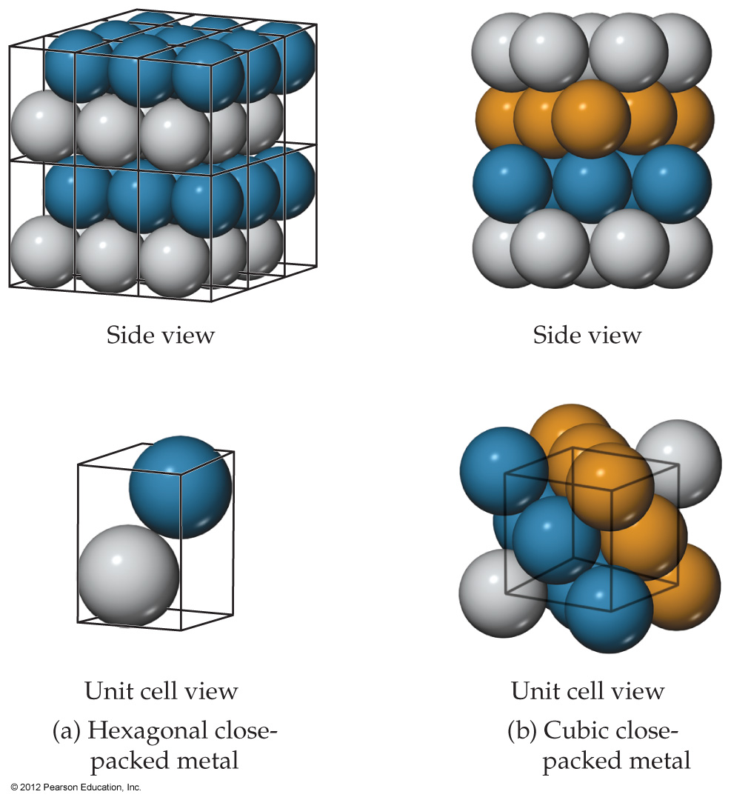
Close Packing
The atoms in a crystal pack as close together as they can based on the respective sizes of the atoms.

Slide 13
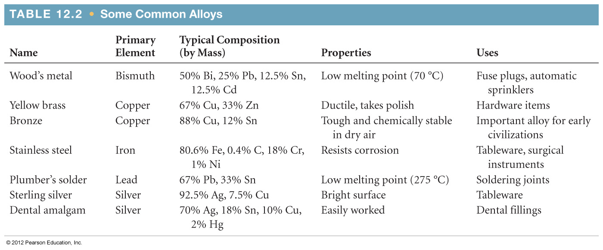
Alloys
Alloys are combinations of two or more elements, the majority of which are metals.
Adding a second (or third) element changes the properties of the mixture to suit different purposes.

Slide 14
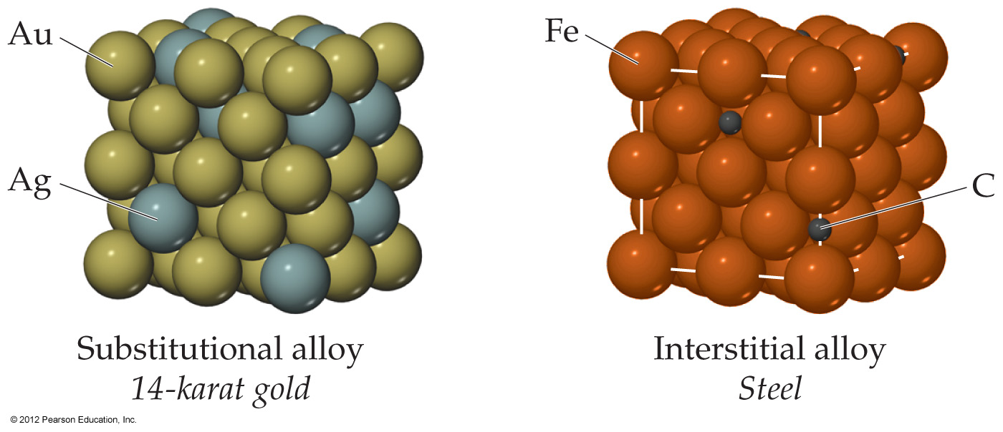
Alloys
In substitutional alloys, a second element takes the place of a metal atom.
In interstitial alloys, a second element fills a space in the lattice of metal atoms.

Slide 15
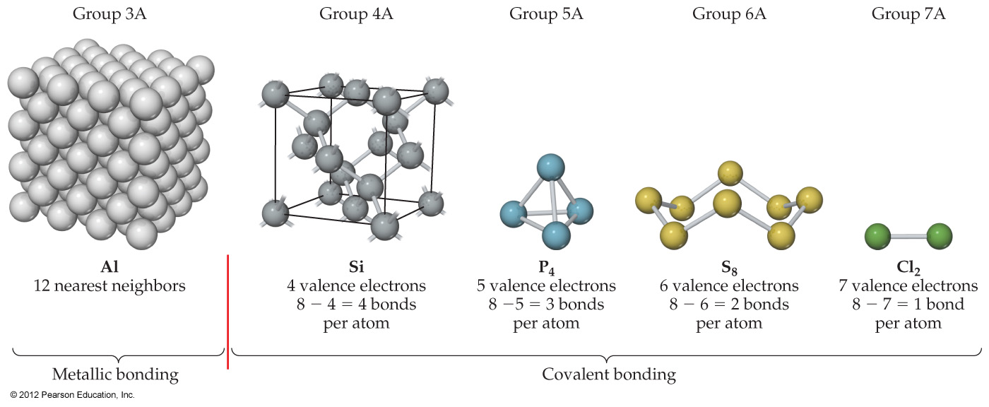
Metallic Bonding
In elemental samples of nonmetals and metalloids, atoms generally bond to each other covalently.
Metals, however, have a dearth of valence electrons; instead, they form large groups of atoms that share electrons among them.

Slide 16
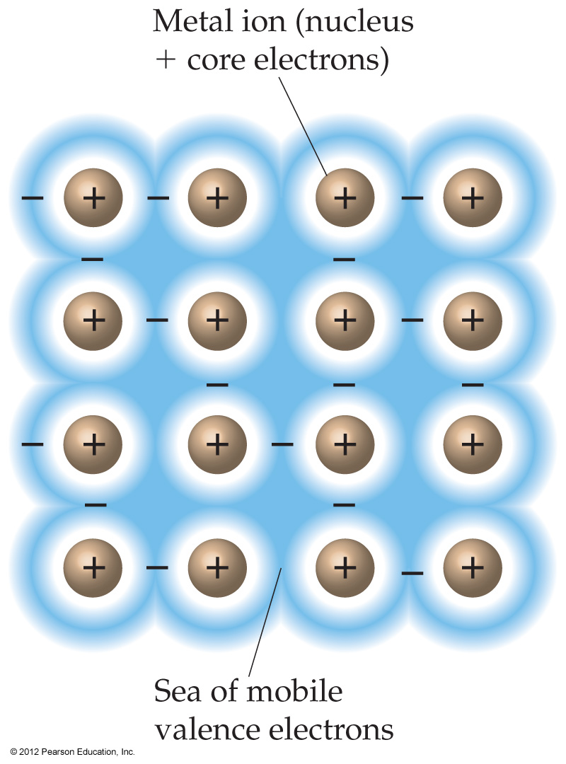
Metallic Bonding
One can think of a metal, therefore, as a group of cations suspended in a sea of electrons.
The electrical and thermal conductivity, ductility, and malleability of metals is explained by this model.

Slide 17
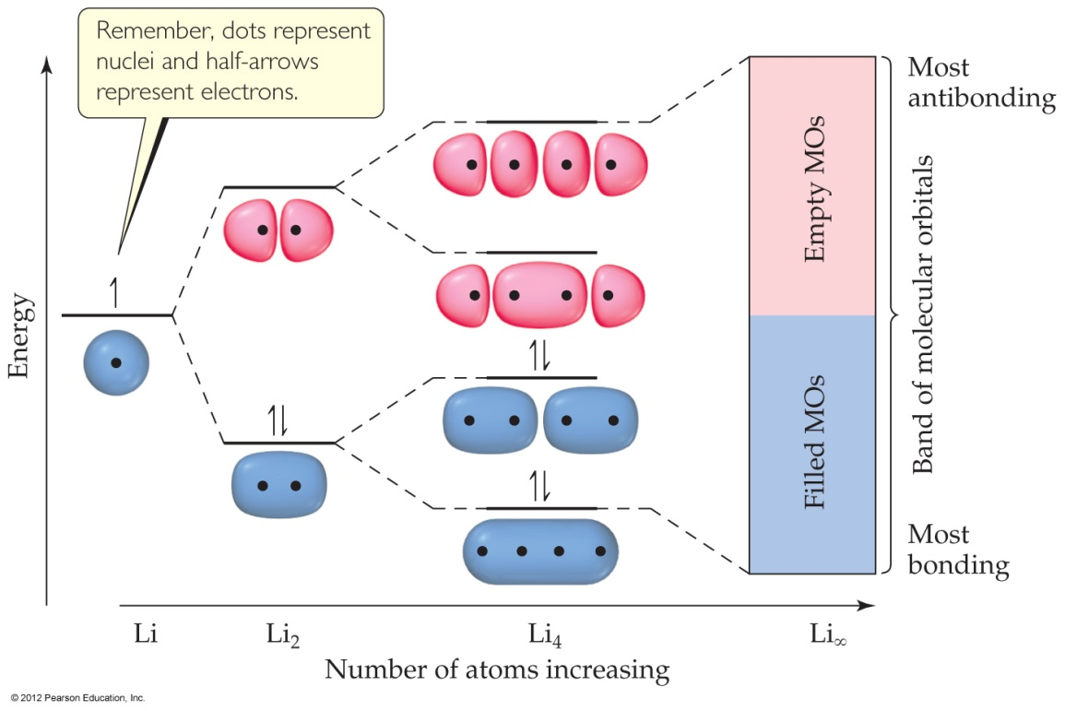
A Molecular-Orbital Approach
As the number of atoms in a chain increases, the energy gap between molecular orbitals (MOs) essentially disappears, and continuous bands of energy states result.

Slide 18
Ionic Solids
In ionic solids, the lattice comprises alternately charged ions.
Ionic solids have very high melting and boiling points and are quintessential crystals.

Slide 19
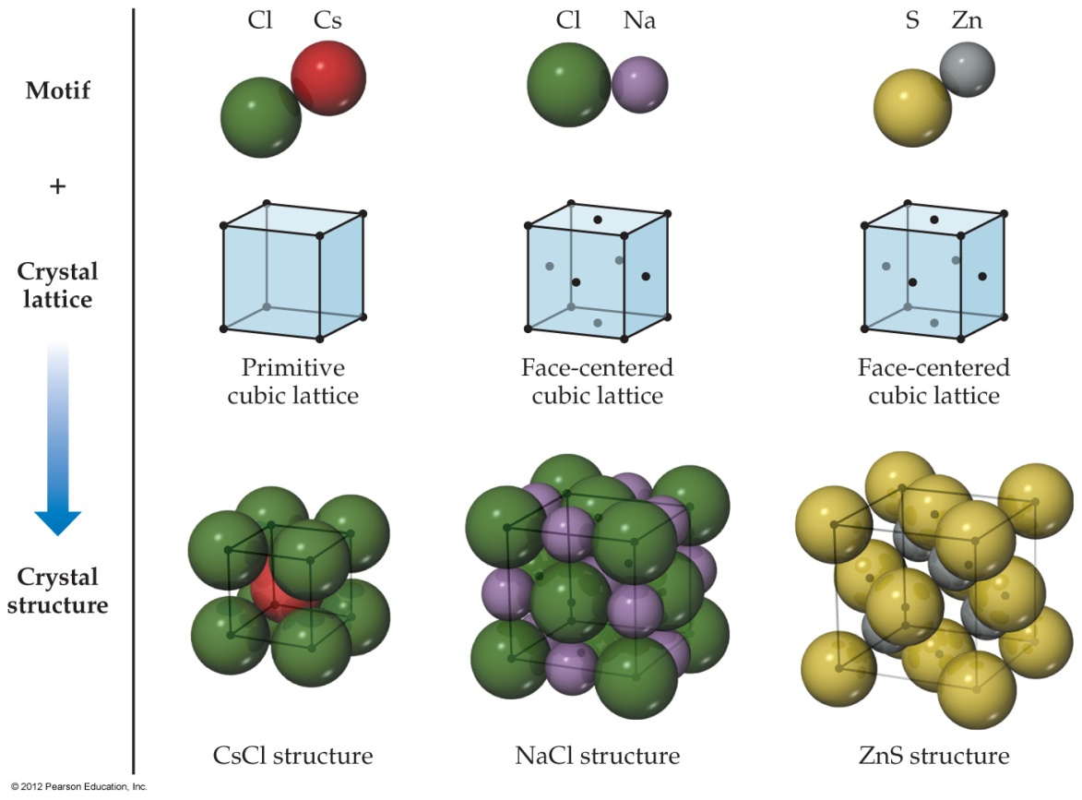
Ionic Solids
The different-sized ions in an ionic compound minimize the distance between oppositely charged ions while keeping like-charged ions away from each other.

Slide 20
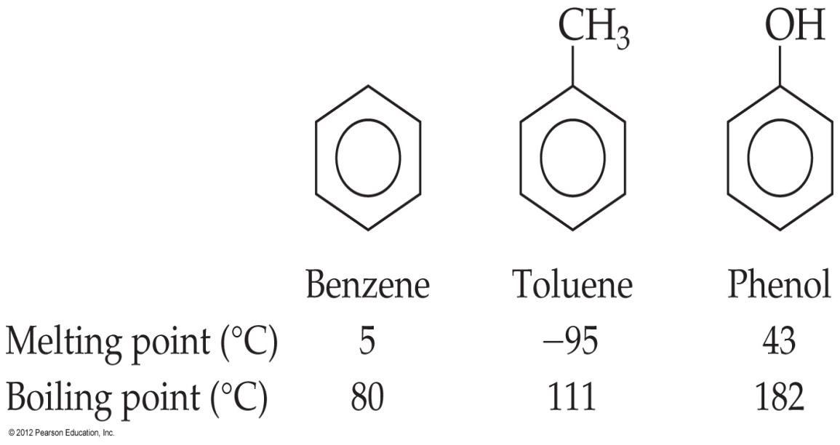
Molecular Solids
The physical properties of molecular solids are governed by van der Waals forces.
The individual units of these solids are discrete molecules.

Slide 21
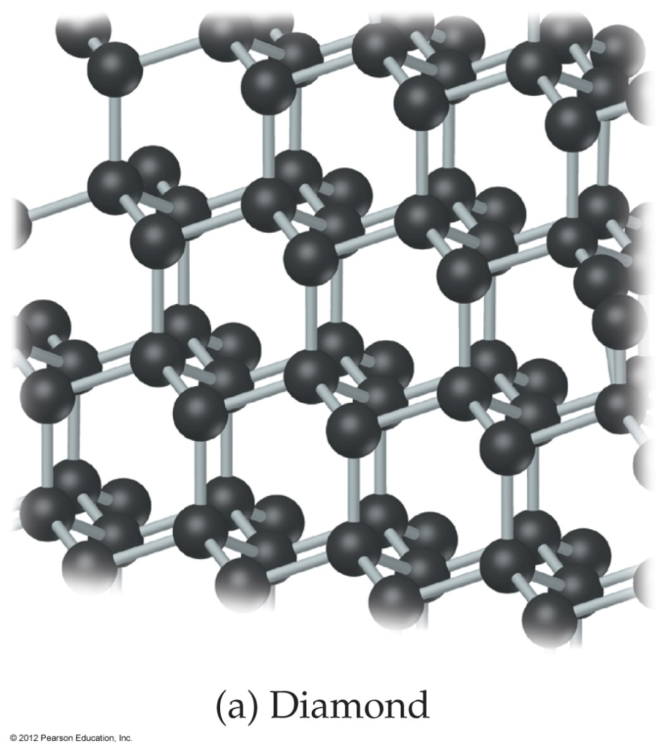
Covalent-Network and Molecular Solids
Diamonds are an example of a covalent-network solid, in which atoms are covalently bonded to each other.
They tend to be hard and have high melting points.

Slide 22
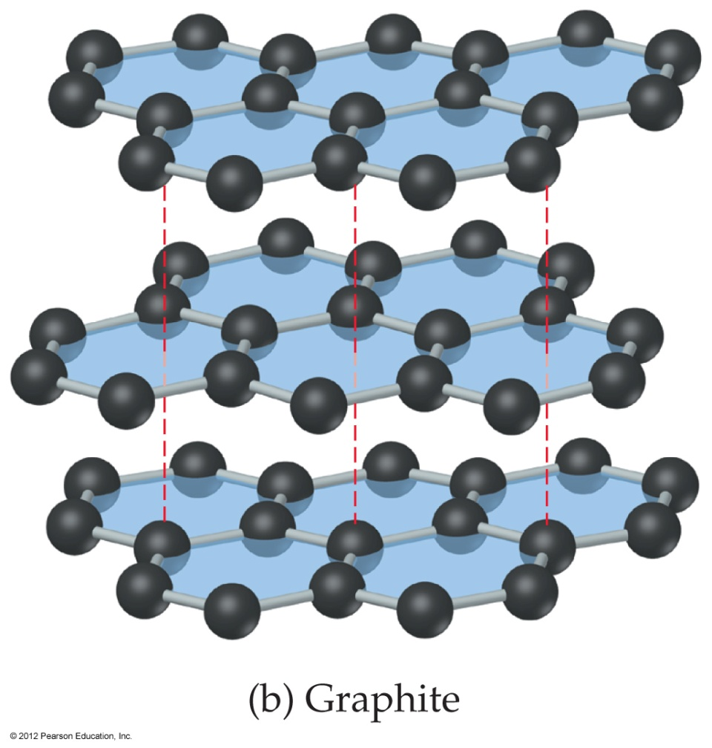
Covalent-Network and Molecular Solids
Graphite is an example of a molecular solid, in which atoms are held together with van der Waals forces.
They tend to be softer and have lower melting points.

Slide 23
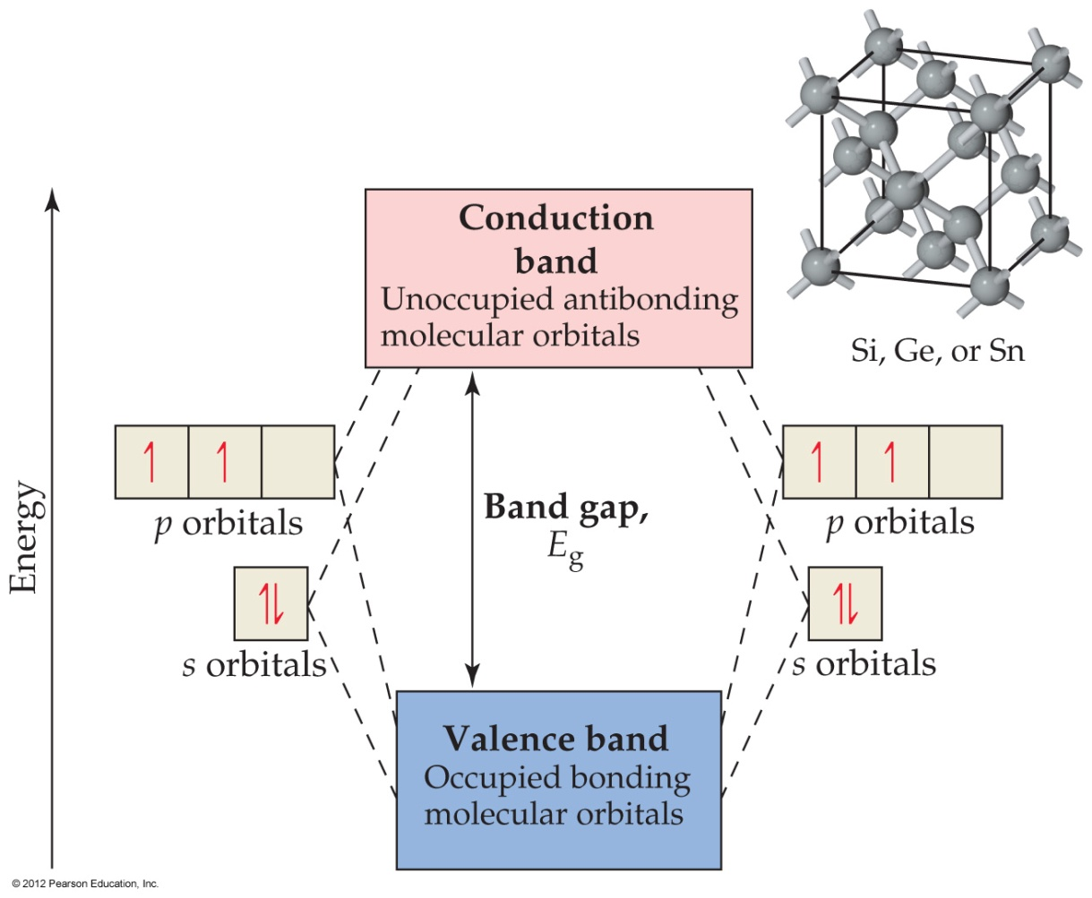
Semiconductors
In the closely packed molecular orbitals in these compounds, there is a gap between the occupied MOs (valence band) and the unoccupied ones (conduction band).

Slide 24
Semiconductors
These Group IVA elements have gaps between their valence and conducting bands of 0.08 to 3.05 eV (7 to 300 kJ/mol).

Slide 25
Semiconductors
Among elements, only Group IVA, all of which have 4 valence electrons, are semiconductors.
Inorganic semiconductors (like GaAs) tend to have an average of 4 valence electrons (3 for Ga, 5 for As).

Slide 26
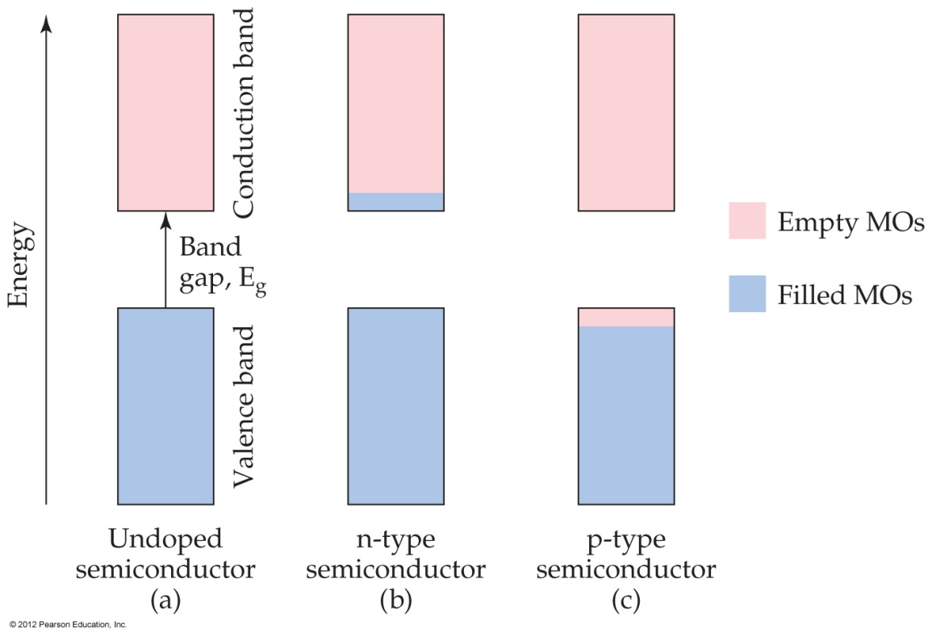
Doping
By introducing very small amounts of impurities that have more (n-type) or fewer (p-type) valence electrons, one can increase the conductivity of a semiconductor.

Slide 27
Polymers
Polymers are molecules of high molecular mass made by sequentially bonding repeating units called monomers.

Slide 28
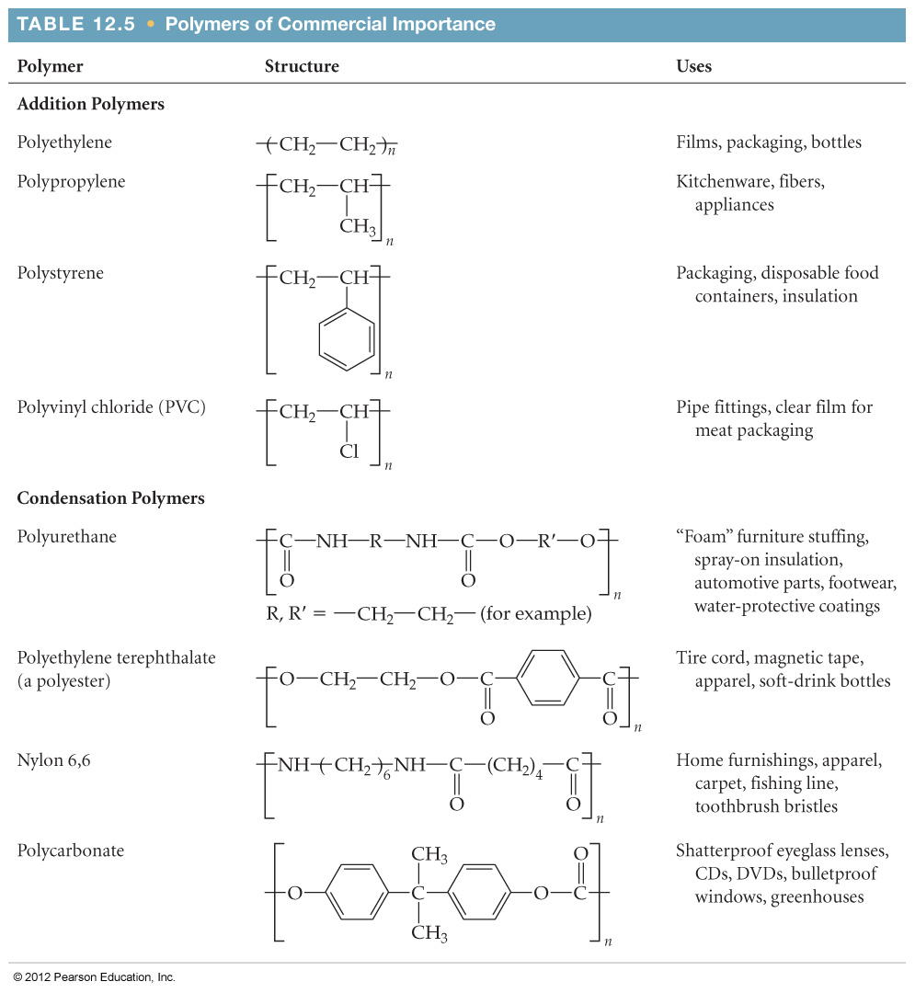
Some Common Polymers

Slide 29
Addition Polymers
Addition polymers are made by coupling the monomers by converting π bonds within each monomer to σ bonds between monomers.

Slide 30
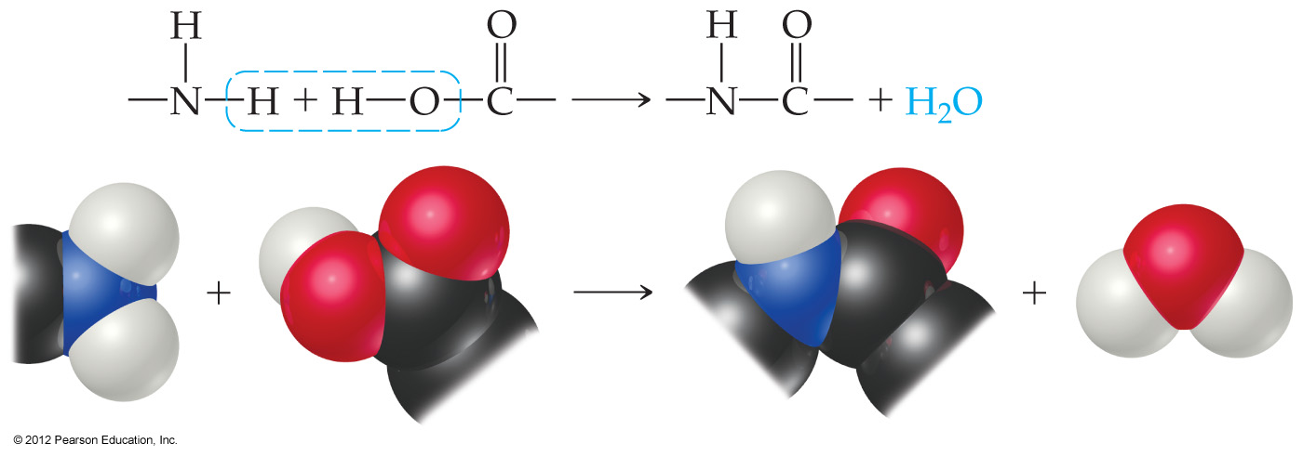
Condensation Polymers
Condensation polymers are made by joining two subunits through a reaction in which a smaller molecule (often water) is also formed as a by-product.
These are also called copolymers.

Slide 31
Synthesis of Nylon
Nylon is one example of a condensation polymer.

Slide 32
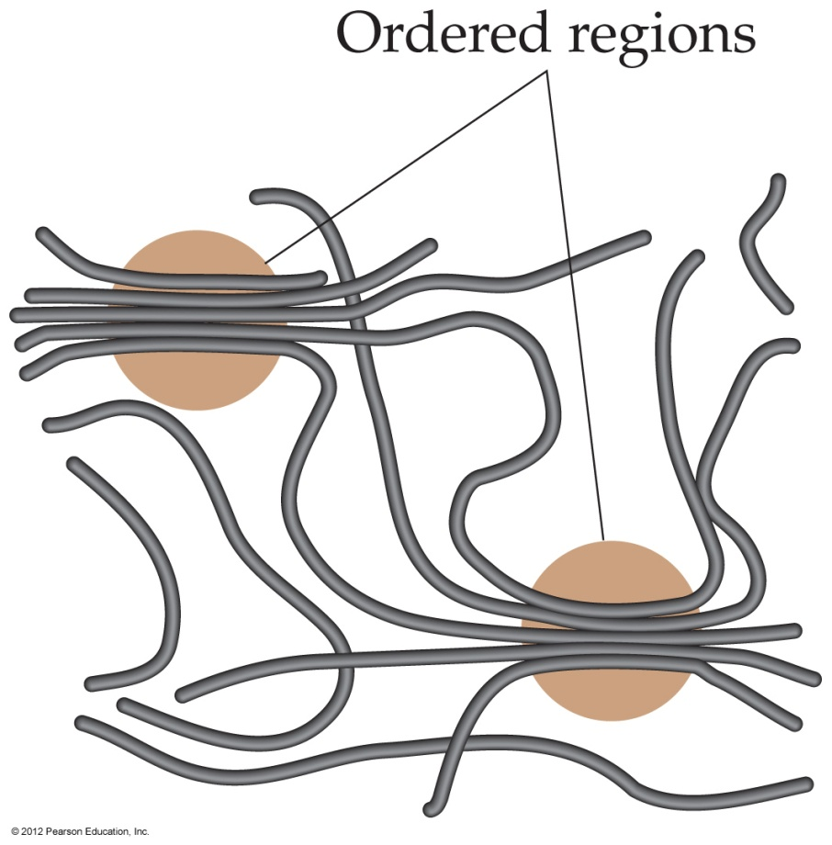
Properties of Polymers
Interactions between chains of a polymer lend elements of order to the structure of polymers.

Slide 33
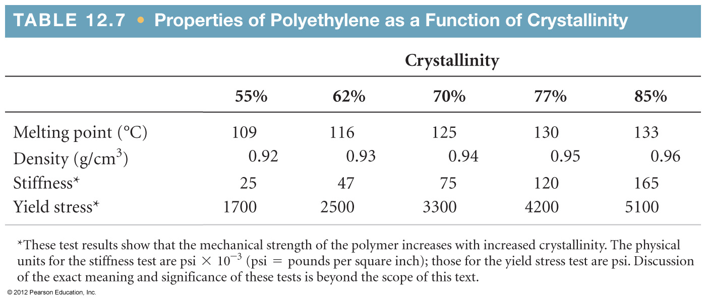
Properties of Polymers
Stretching the polymer chains as they form can increase the amount of order, leading to a degree of crystallinity of the polymer.

Slide 34
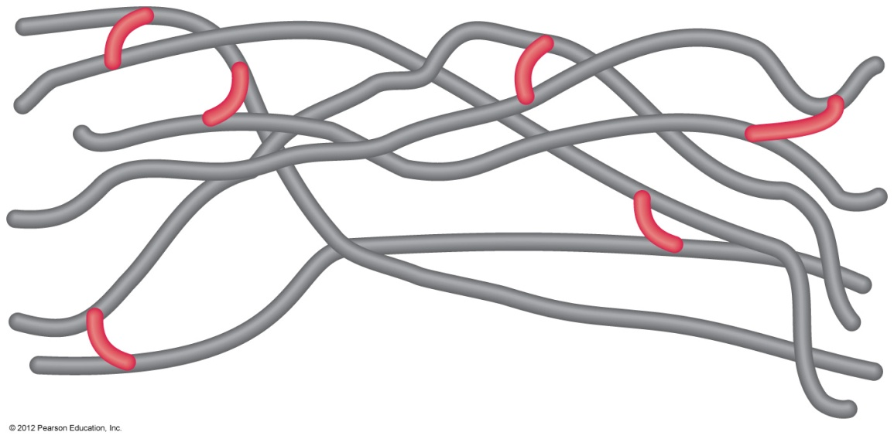
Cross-Linking
Chemically bonding chains of polymers to each other can stiffen and strengthen the substance.

Slide 35
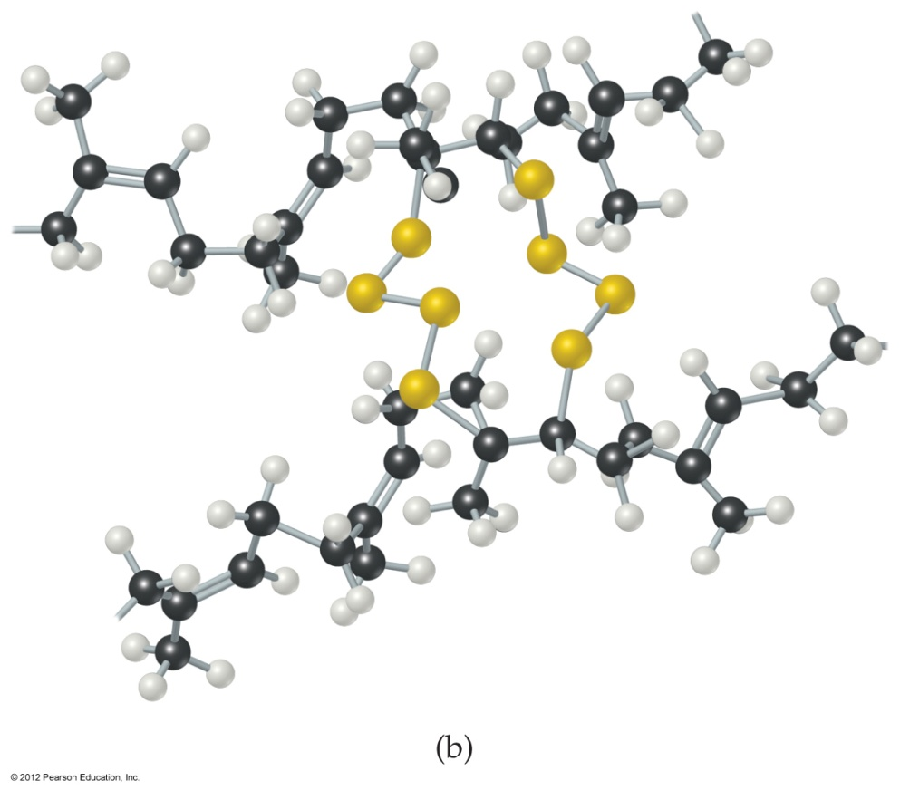
Cross-Linking
Naturally occurring rubber is too soft and pliable for many applications.

Slide 36
Cross-Linking
In vulcanization, chains are cross-linked by short chains of sulfur atoms, making the rubber stronger and less susceptible to degradation.

Slide 37
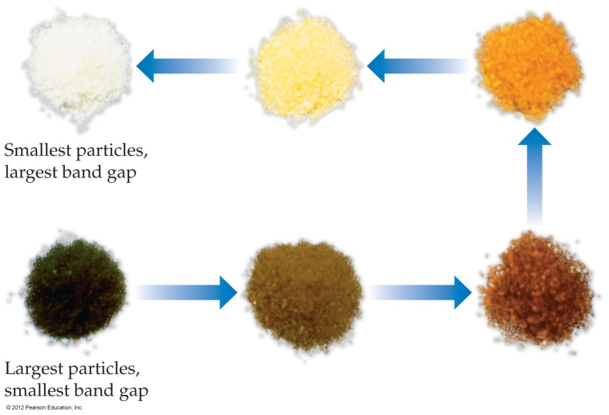
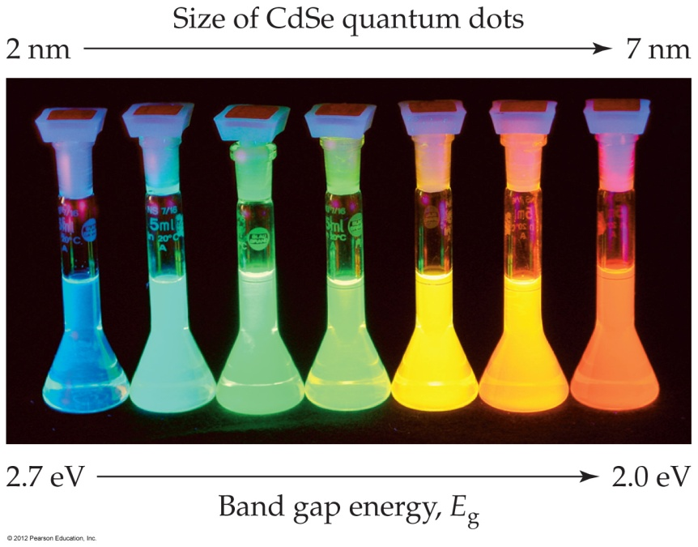
Nanoparticles
Different size particles of a semiconductor (like Cd₃P₂) can emit different wavelengths of light, depending on the size of the energy gap between bands.

Slide 38
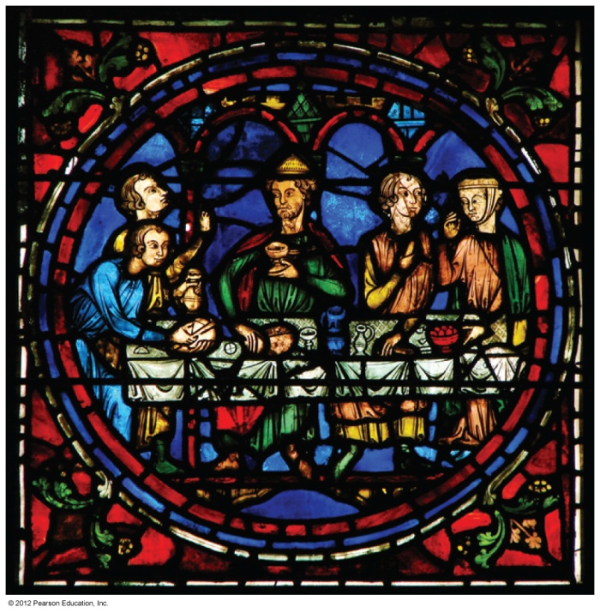
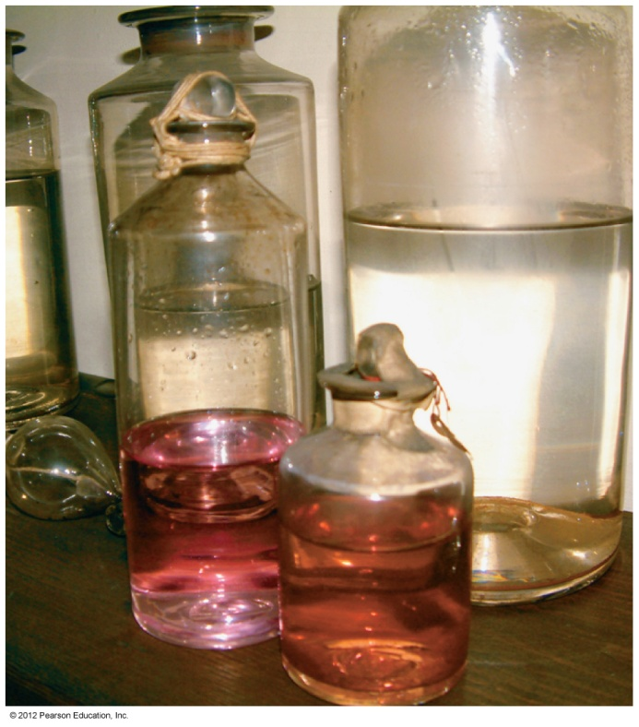
Nanoparticles
Finely divided metals can have quite different properties than larger samples of metals.

Slide 39
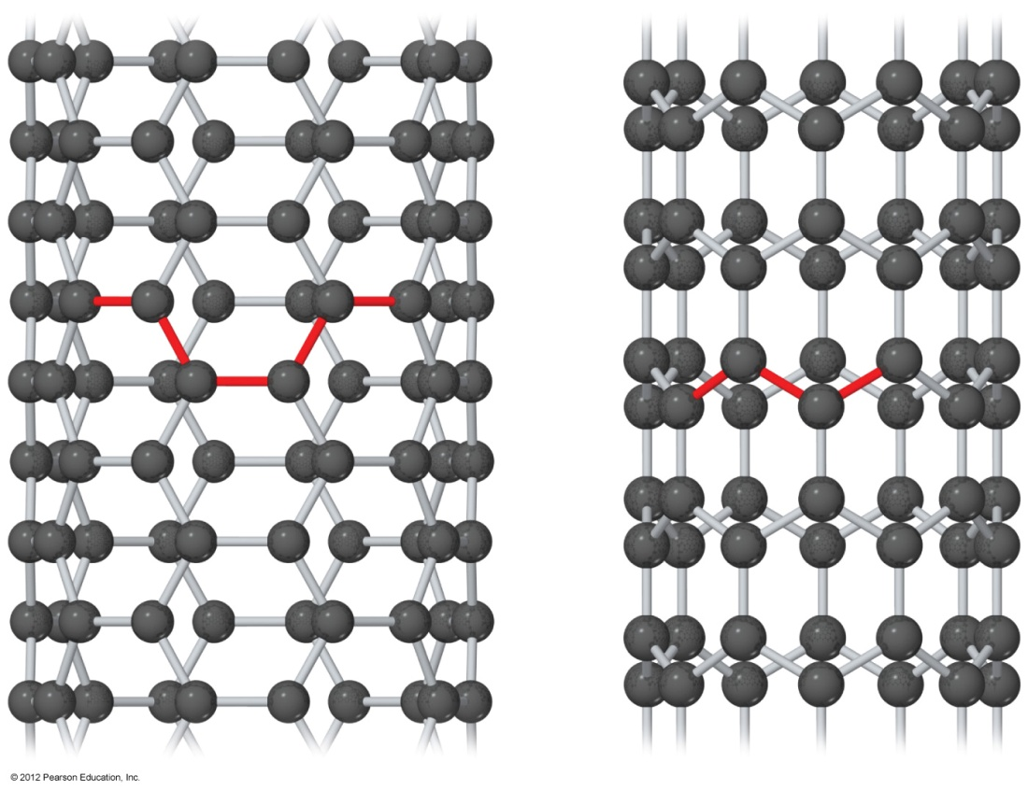
Carbon Nanotubes
Carbon nanotubes can be made with metallic or semiconducting properties without doping.

