Slide 1
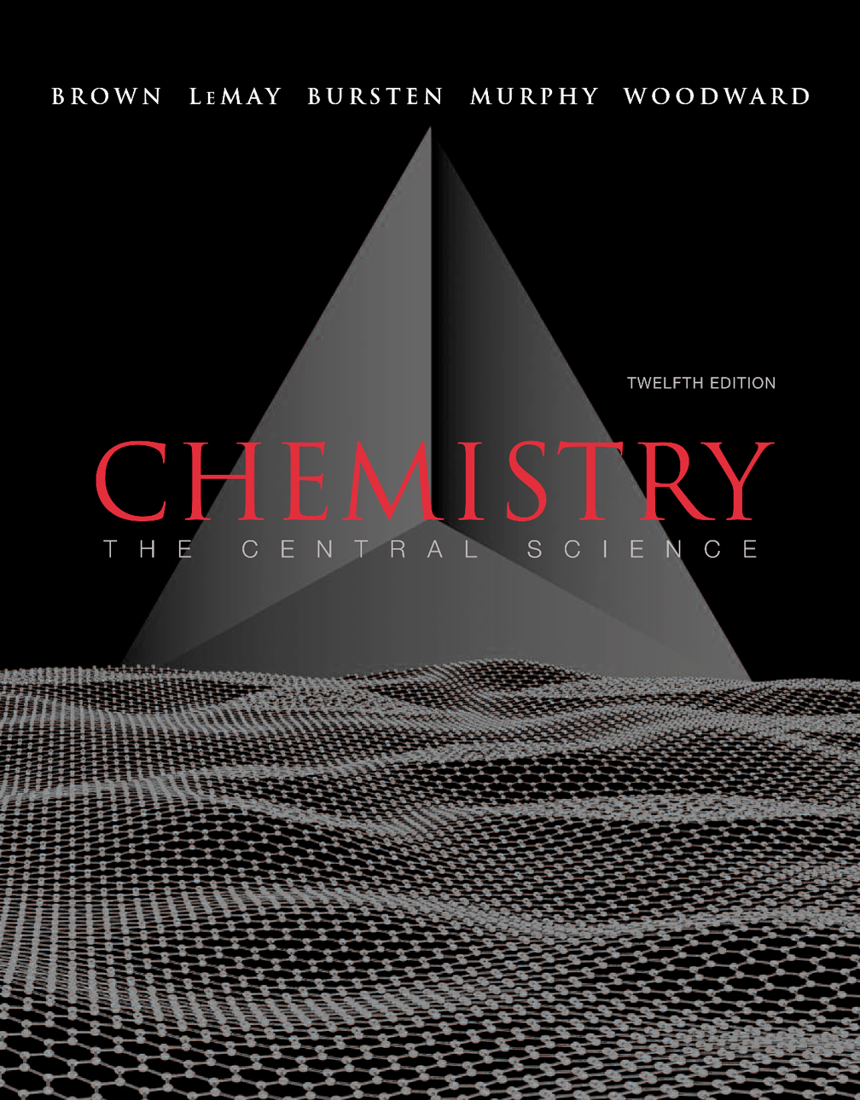
Chapter 13
Properties of Solutions
Lecture Presentation
John D. Bookstaver
St. Charles Community College
Cottleville, MO
© 2012 Pearson Education, Inc.

Slide 2
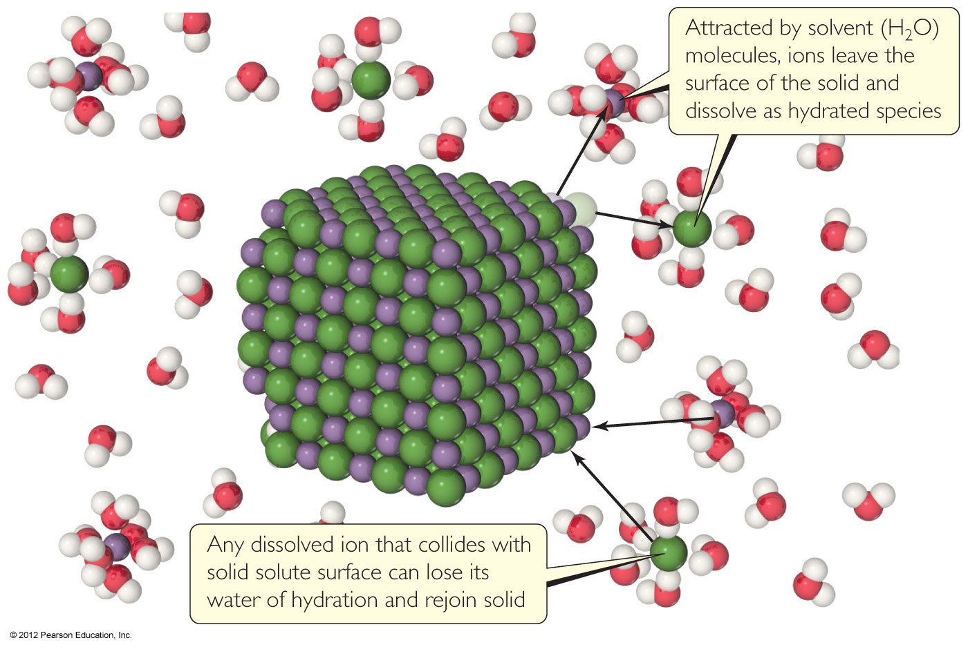
Solutions
Solutions are homogeneous mixtures of two or more pure substances.
In a solution, the solute is dispersed uniformly throughout the solvent.
© 2012 Pearson Education, Inc.

Slide 3
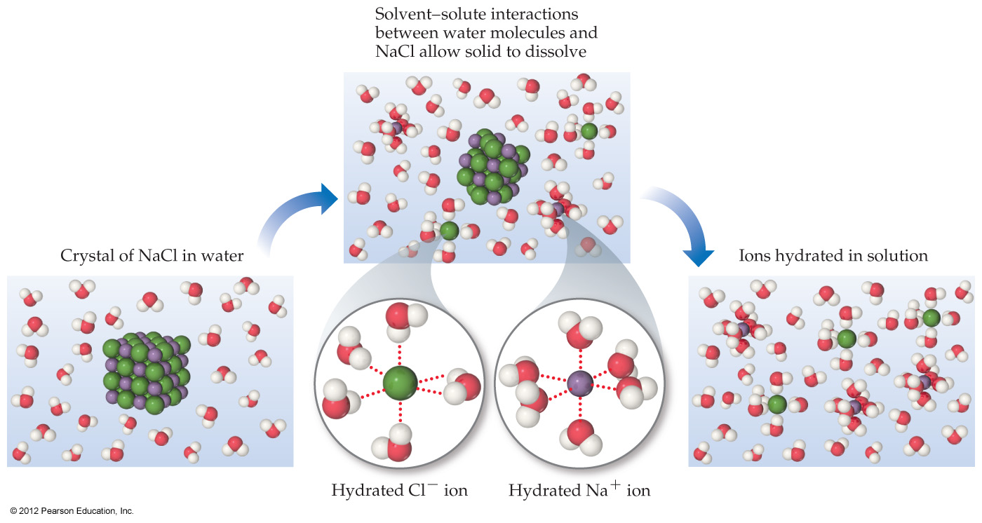
Solutions
The intermolecular forces between solute and solvent particles must be strong enough to compete with those between solute particles and those between solvent particles.
© 2012 Pearson Education, Inc.

Slide 4
How Does a Solution Form?
As a solution forms, the solvent pulls solute particles apart and surrounds, or solvates, them.
© 2012 Pearson Education, Inc.

Slide 5
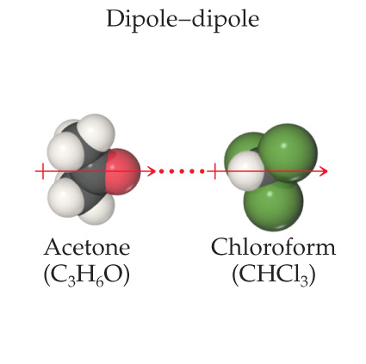
How Does a Solution Form?
If an ionic salt is soluble in water, it is because the ion–dipole interactions are strong enough to overcome the lattice energy of the salt crystal.
© 2012 Pearson Education, Inc.

Slide 6
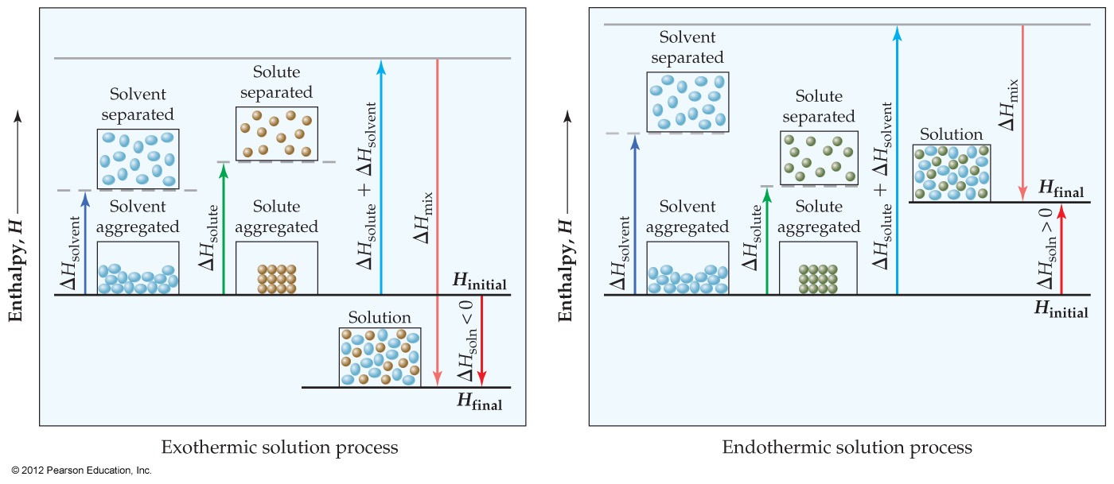
Energy Changes in Solution
Simply put, three processes affect the energetics of solution:
  Separation of solute particles,
  Separation of solvent particles,
  New interactions between solute and solvent.
© 2012 Pearson Education, Inc.

Slide 7
Energy Changes in Solution
The enthalpy change of the overall process depends on ΔH for each of these steps.
© 2012 Pearson Education, Inc.

Slide 8
Why Do Endothermic Processes Occur?
Things do not tend to occur spontaneously (i.e., without outside intervention) unless the energy of the system is lowered.
© 2012 Pearson Education, Inc.

Slide 9
Why Do Endothermic Processes Occur?
Yet we know that in some processes, like the dissolution of NH₄NO₃ in water, heat is absorbed, not released.
© 2012 Pearson Education, Inc.

Slide 10
Enthalpy Is Only Part of the Picture
The reason is that increasing the disorder or randomness (known as entropy) of a system tends to lower the energy of the system.
© 2012 Pearson Education, Inc.

Slide 11
Enthalpy Is Only Part of the Picture
So even though enthalpy may increase, the overall energy of the system can still decrease if the system becomes more disordered.
© 2012 Pearson Education, Inc.

Slide 12
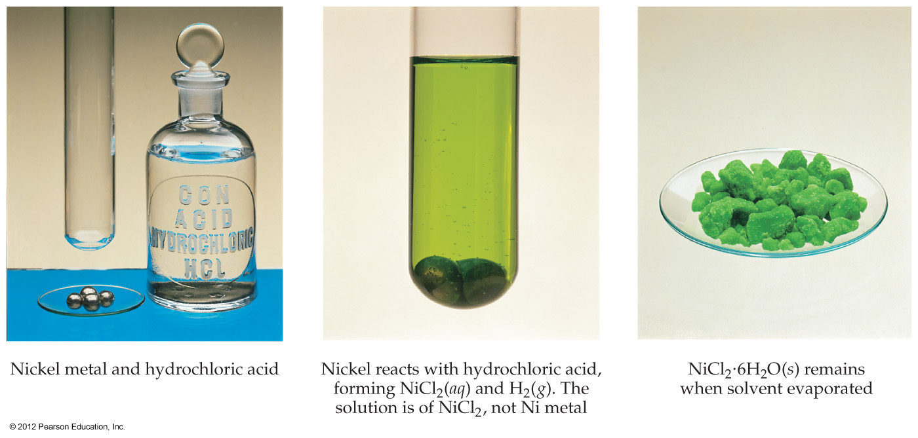
Student, Beware!
Just because a substance disappears when it comes in contact with a solvent, it doesn’t mean the substance dissolved. It may have reacted.
© 2012 Pearson Education, Inc.

Slide 13
Student, Beware!
Dissolution is a physical change—you can get back the original solute by evaporating the solvent.
If you can’t get it back, the substance didn’t dissolve, it reacted.
© 2012 Pearson Education, Inc.

Slide 14
Types of Solutions
Saturated
  In a saturated solution, the solvent holds as much solute as is possible at that temperature.
  Dissolved solute is in dynamic equilibrium with solid solute particles.
© 2012 Pearson Education, Inc.

Slide 15
Types of Solutions
Unsaturated
  If a solution is unsaturated, less solute than can dissolve in the solvent at that temperature is dissolved in the solvent.
© 2012 Pearson Education, Inc.

Slide 16
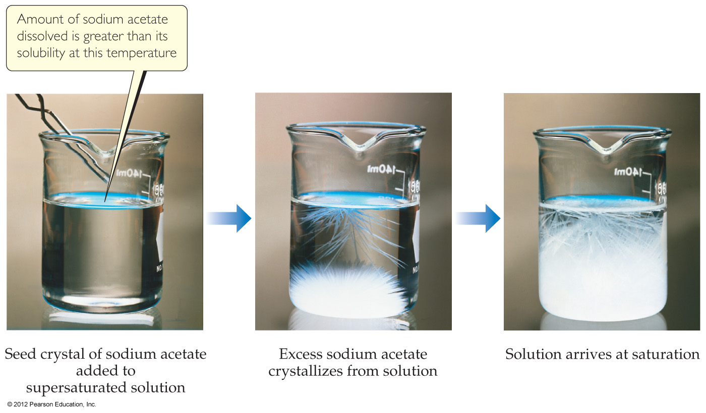
Types of Solutions
Supersaturated
  In supersaturated solutions, the solvent holds more solute than is normally possible at that temperature.
  These solutions are unstable; crystallization can usually be stimulated by adding a “seed crystal” or scratching the side of the flask.
© 2012 Pearson Education, Inc.

Slide 17
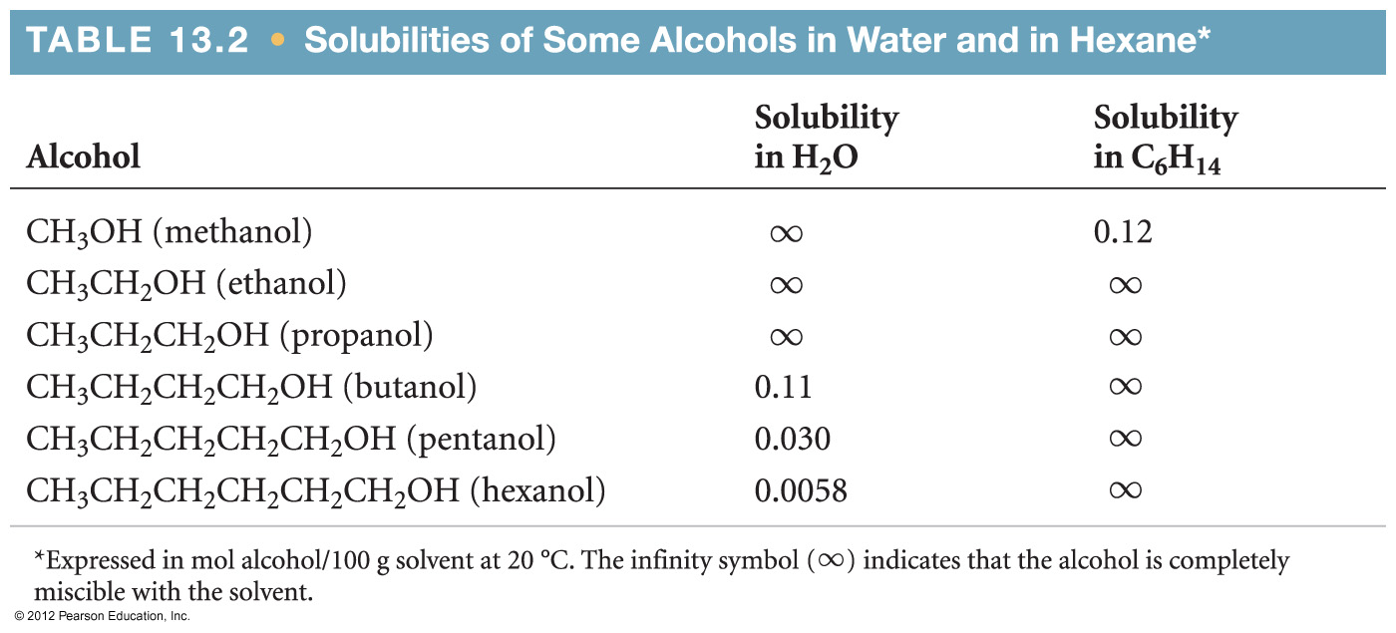
Factors Affecting Solubility
Chemists use the axiom “like dissolves like.”
  Polar substances tend to dissolve in polar solvents.
  Nonpolar substances tend to dissolve in nonpolar solvents.
© 2012 Pearson Education, Inc.

Slide 18
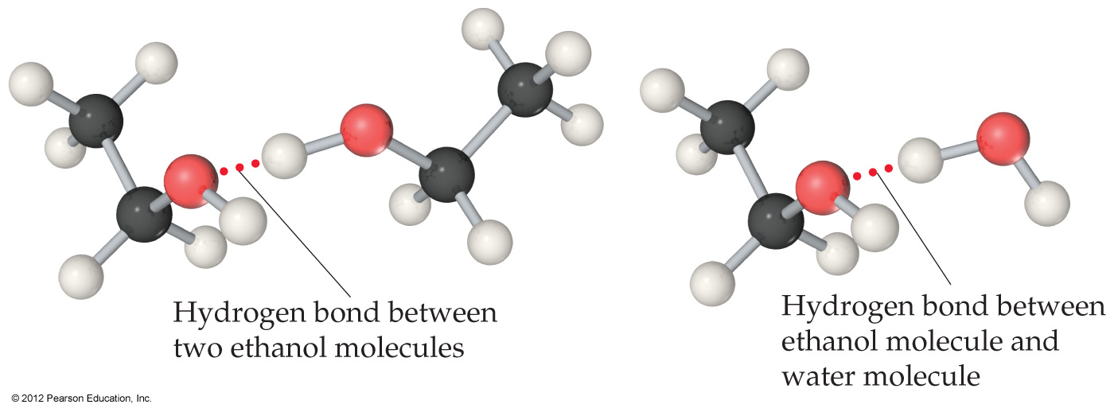
Factors Affecting Solubility
The more similar the intermolecular attractions, the more likely one substance is to be soluble in another.
© 2012 Pearson Education, Inc.

Slide 19
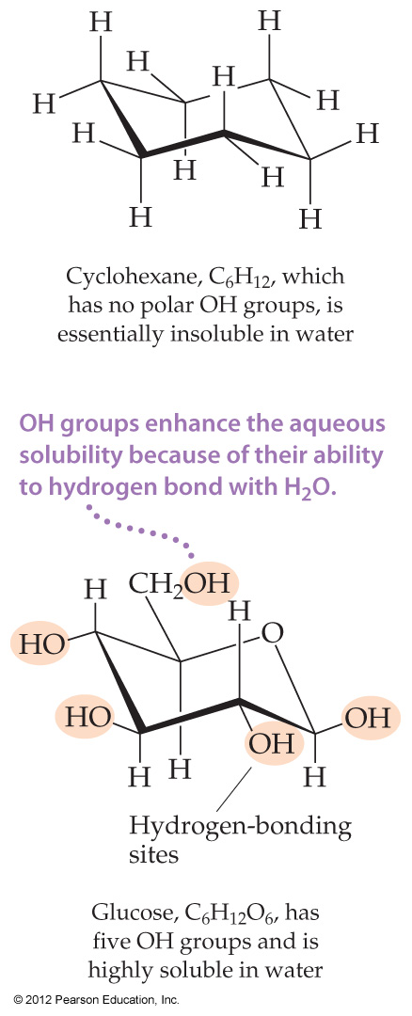
Factors Affecting Solubility
Glucose (which has hydrogen bonding) is very soluble in water, while cyclohexane (which only has dispersion forces) is not.
© 2012 Pearson Education, Inc.

Slide 20
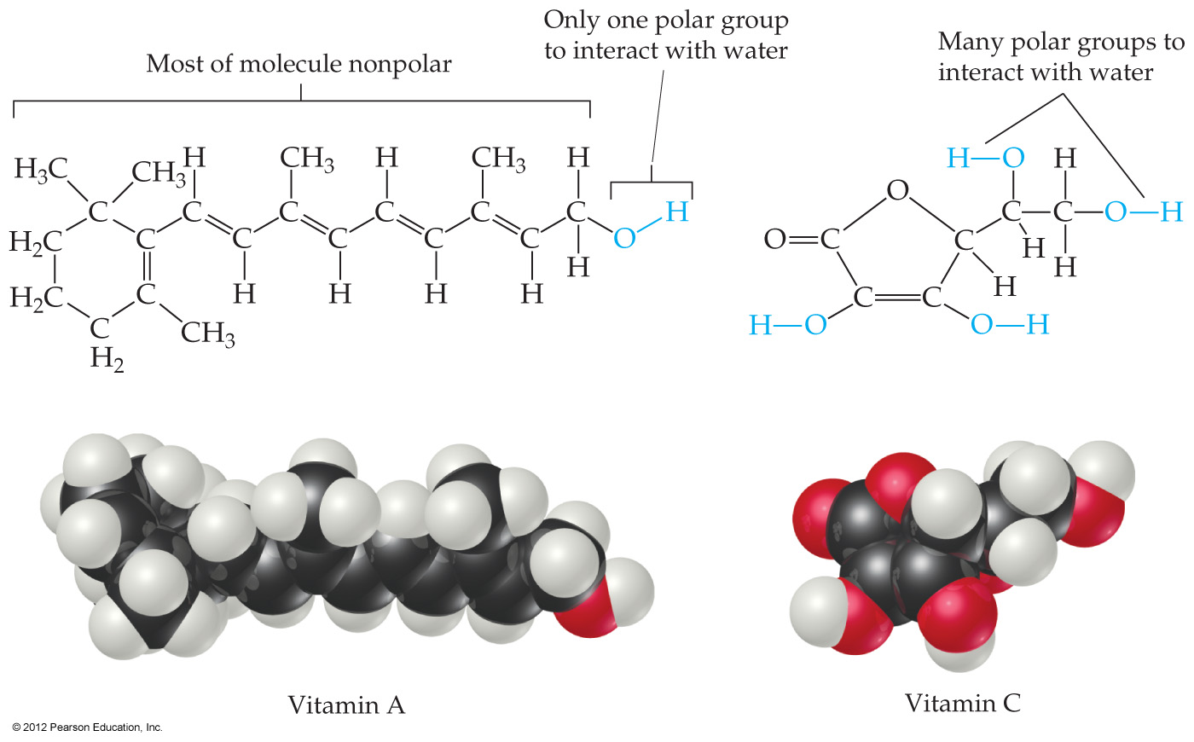
Factors Affecting Solubility
Vitamin A is soluble in nonpolar compounds (like fats).
Vitamin C is soluble in water.
© 2012 Pearson Education, Inc.

Slide 21
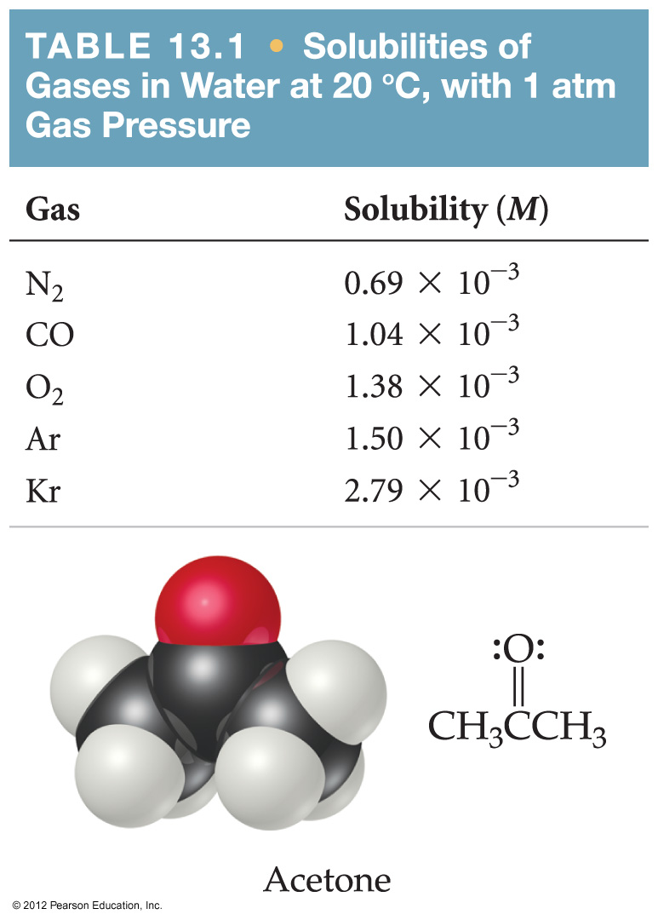
Gases in Solution
In general, the solubility of gases in water increases with increasing mass.
Larger molecules have stronger dispersion forces.
© 2012 Pearson Education, Inc.

Slide 22
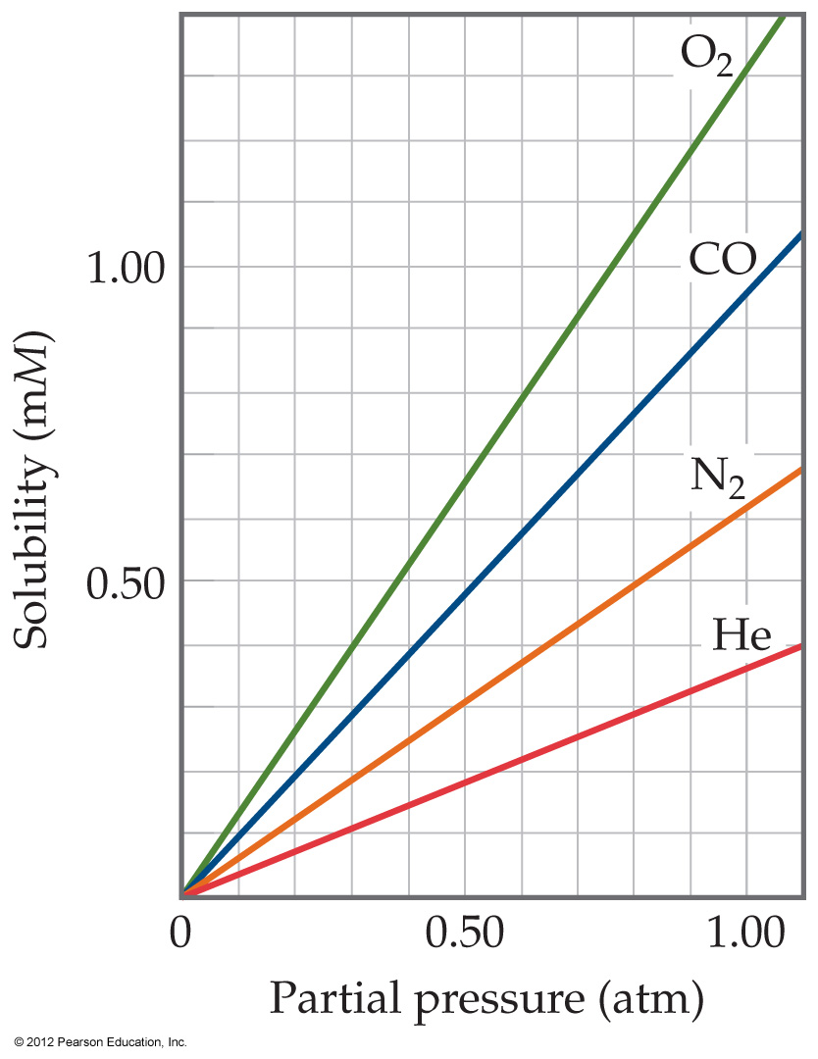
Gases in Solution
The solubility of liquids and solids does not change appreciably with pressure.
But the solubility of a gas in a liquid is directly proportional to its pressure.
© 2012 Pearson Education, Inc.
Notes:
Start here 1/21/10--8:30 & 10

Slide 23
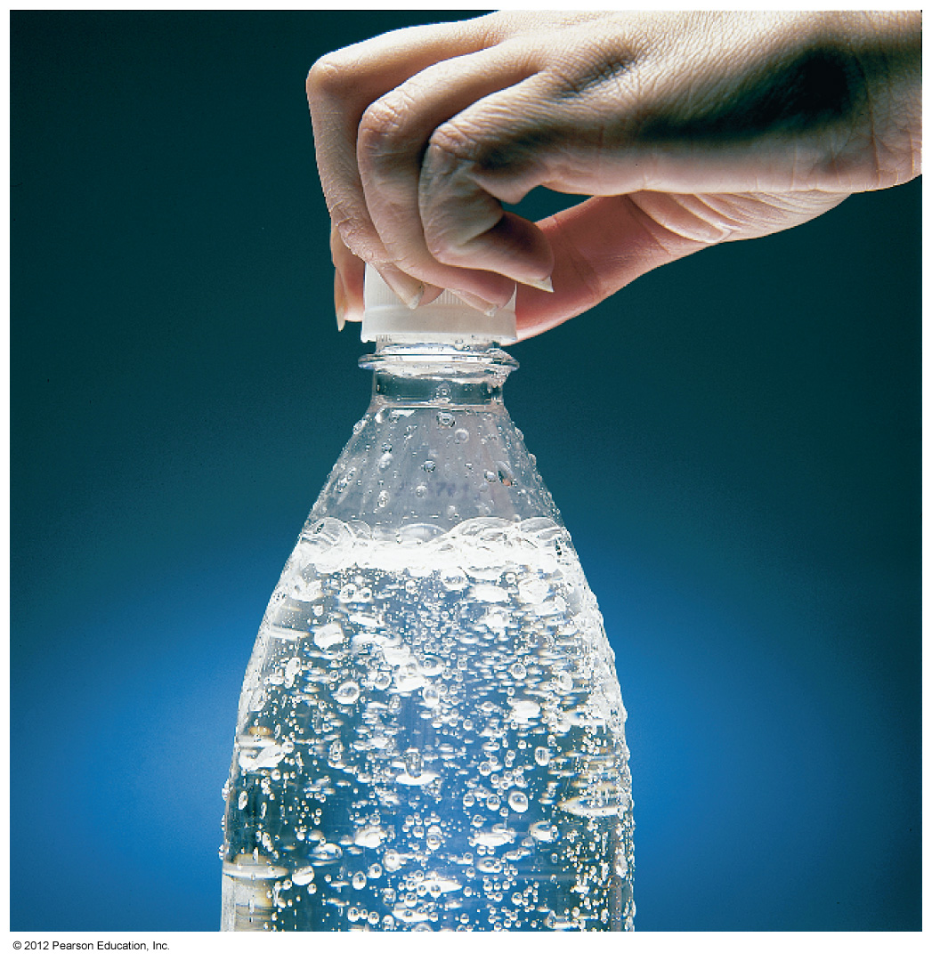
Henry’s Law
S_{g} = kP_{g}
where
S_{g} is the solubility of the gas,
k is the Henry’s Law constant for that gas in that solvent, and
P_{g} is the partial pressure of the gas above the liquid.
© 2012 Pearson Education, Inc.

Slide 24
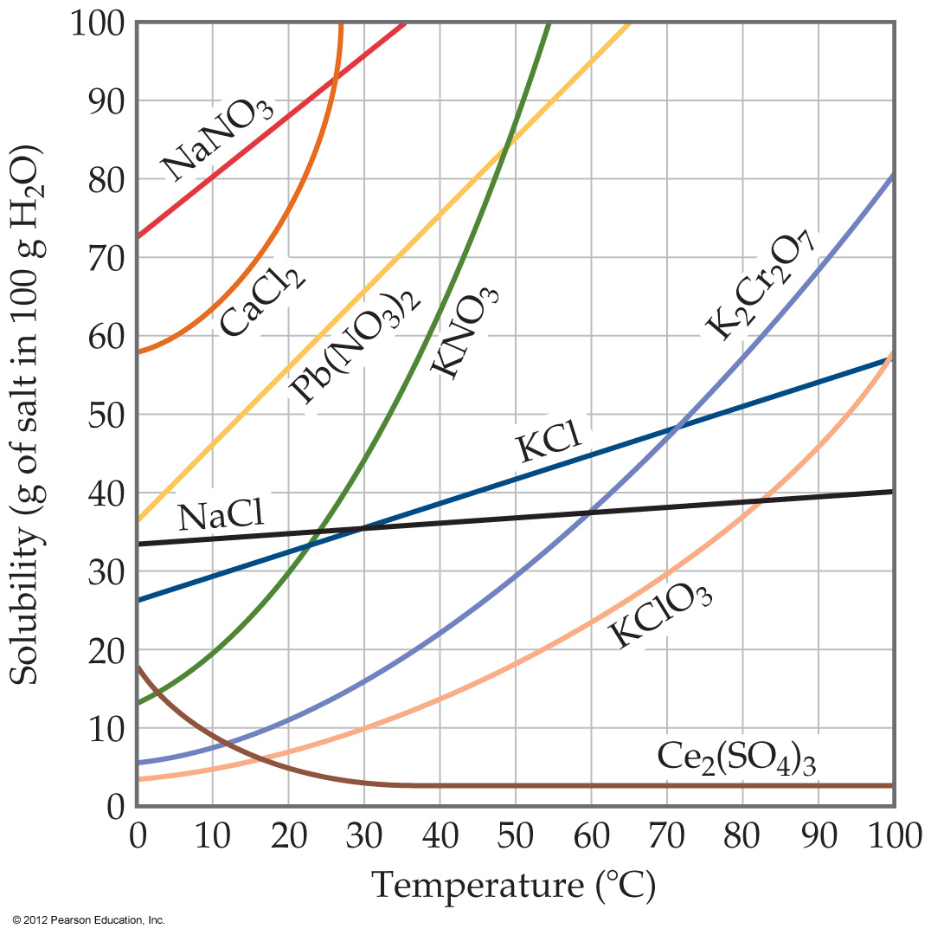
Temperature
Generally, the solubility of solid solutes in liquid solvents increases with increasing temperature.
© 2012 Pearson Education, Inc.

Slide 25
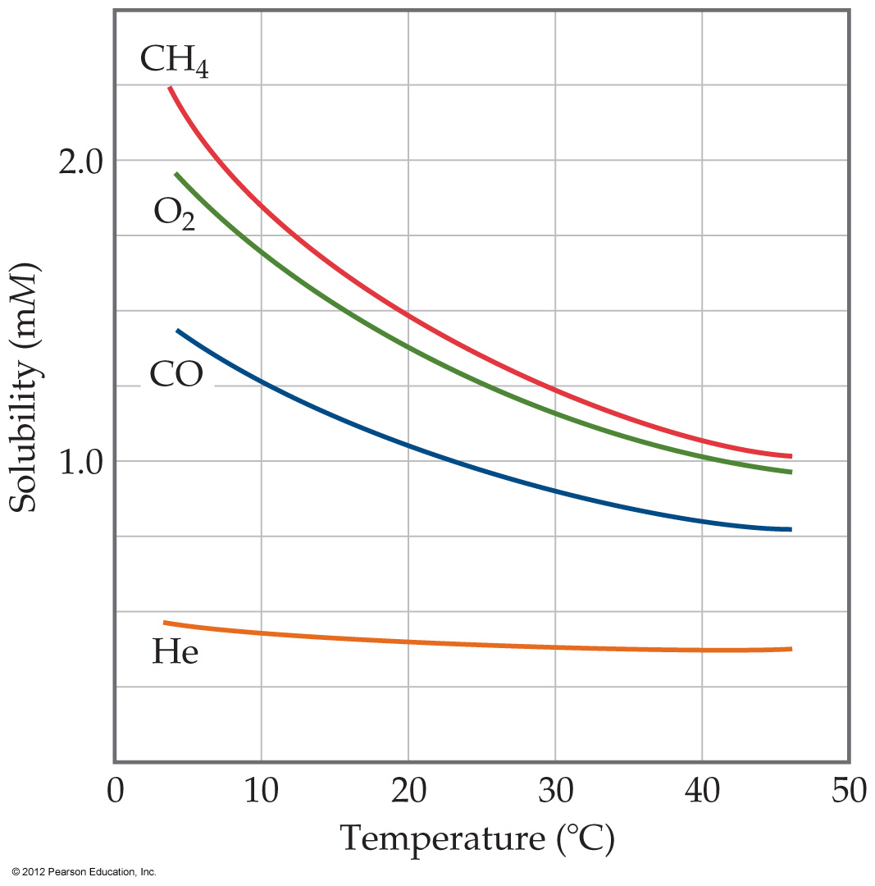
Temperature
The opposite is true of gases.
  Carbonated soft drinks are more “bubbly” if stored in the refrigerator.
  Warm lakes have less O₂ dissolved in them than cool lakes.
© 2012 Pearson Education, Inc.

Slide 26
Ways of Expressing Concentrations of Solutions
© 2012 Pearson Education, Inc.

Slide 27
Mass Percentage
mass of A in solution
total mass of solution
Mass % of A =
× 100
© 2012 Pearson Education, Inc.

Slide 28
Parts per Million and
Parts per Billion
Parts per million (ppm)
mass of A in solution
total mass of solution
ppm =
× 10⁶
Parts per billion (ppb)
mass of A in solution
total mass of solution
ppb =
× 10⁹
© 2012 Pearson Education, Inc.

Slide 29
Mole Fraction (X)
moles of A
total moles of all components
X_{A} =
In some applications, one needs the mole fraction of solvent, not solute—make sure you find the quantity you need!
© 2012 Pearson Education, Inc.

Slide 30
Molarity (M)
moles of solute
liters of solution
M =
You will recall this concentration measure from Chapter 4.
Since volume is temperature-dependent, molarity can change with temperature.
© 2012 Pearson Education, Inc.

Slide 31
Molality (m)
moles of solute
kilograms of solvent
m =
Since both moles and mass do not change with temperature, molality (unlike molarity) is not temperature-dependent.
© 2012 Pearson Education, Inc.

Slide 32
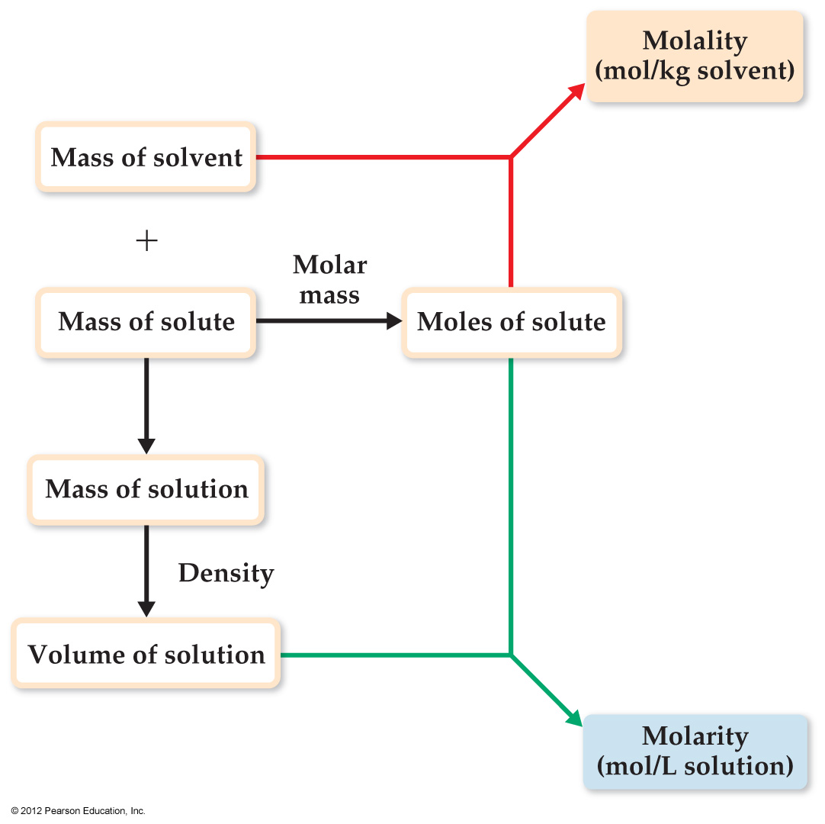
Changing Molarity to Molality
If we know the density of the solution, we can calculate the molality from the molarity, and vice versa.
© 2012 Pearson Education, Inc.

Slide 33
Colligative Properties
Changes in colligative properties depend only on the number of solute particles present, not on the identity of the solute particles.
Among colligative properties are
  Vapor-pressure lowering
  Boiling-point elevation
  Melting-point depression
  Osmotic pressure
© 2012 Pearson Education, Inc.

Slide 34
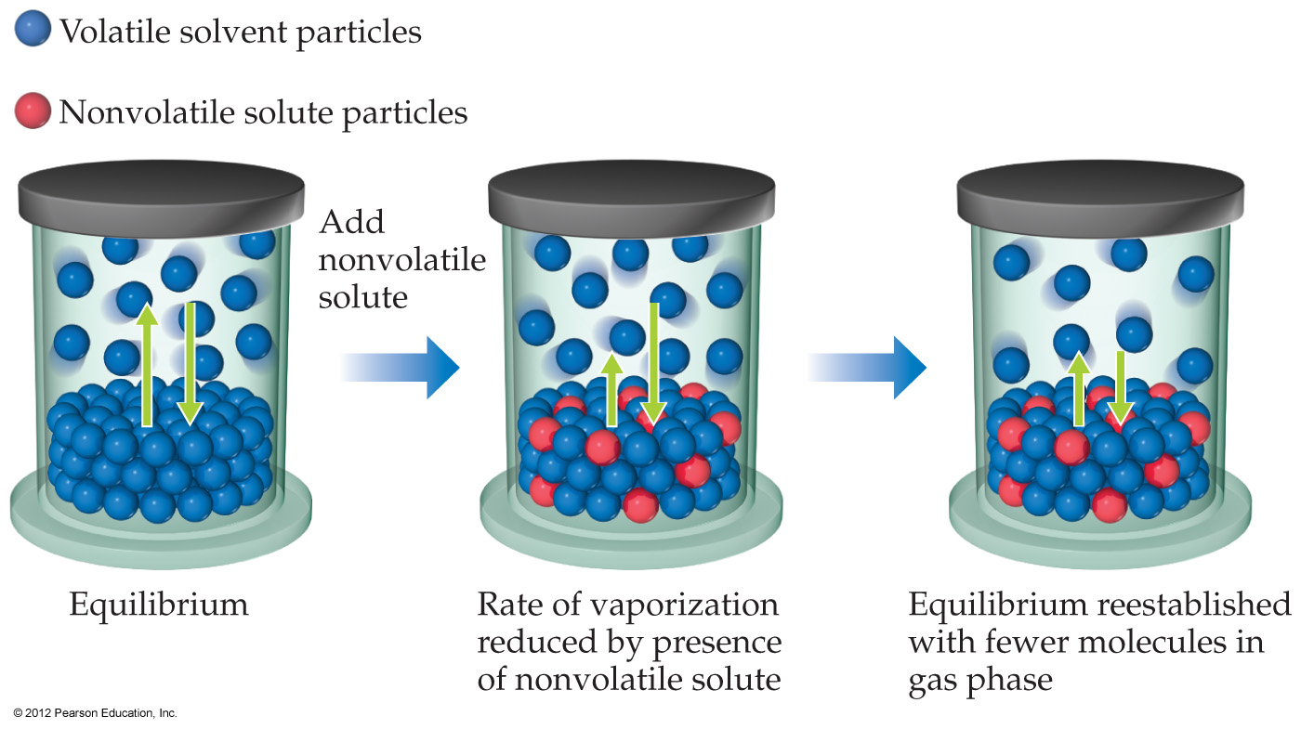
Vapor Pressure
Because of solute–solvent intermolecular attraction, higher concentrations of nonvolatile solutes make it harder for solvent to escape to the vapor phase.
© 2012 Pearson Education, Inc.

Slide 35
Vapor Pressure
Therefore, the vapor pressure of a solution is lower than that of the pure solvent.
© 2012 Pearson Education, Inc.

Slide 36
Raoult’s Law
P_{A} = X_{A}P°_{A}
where
  X_{A} is the mole fraction of compound A, and
  P°_{A} is the normal vapor pressure of A at that temperature.
  Note: This is one of those times when you want to make sure you have the vapor pressure of the solvent.
© 2012 Pearson Education, Inc.

Slide 37
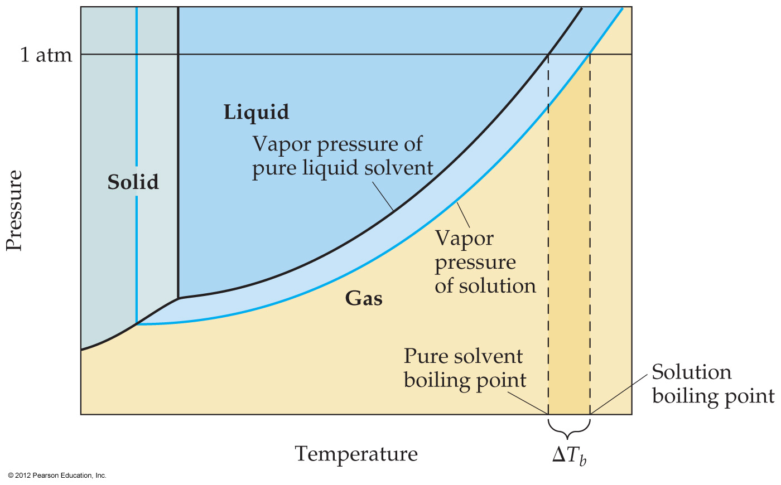
Boiling-Point Elevation and Freezing-Point Depression
Nonvolatile solute–solvent interactions also cause solutions to have higher boiling points and lower freezing points than the pure solvent.
© 2012 Pearson Education, Inc.

Slide 38
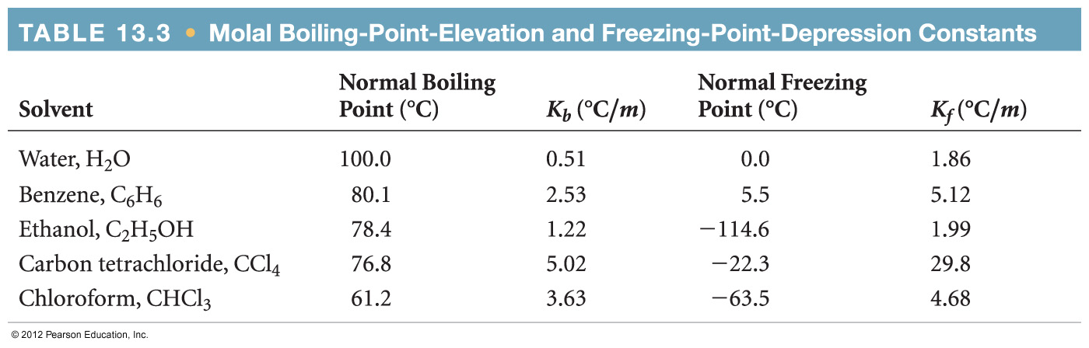
Boiling-Point Elevation
The change in boiling point is proportional to the molality of the solution:
ΔT_{b} = K_{b} • m
where K_{b} is the molal boiling-point elevation constant, a property of the solvent.
ΔT_{b} is added to the normal boiling point of the solvent.
© 2012 Pearson Education, Inc.

Slide 39
Boiling-Point Elevation
The change in freezing point can be found similarly:
ΔT_{f} = K_{f} • m
Here K_{f} is the molal freezing-point depression constant of the solvent.
ΔT_{f} is subtracted from the normal freezing point of the solvent.
© 2012 Pearson Education, Inc.

Slide 40
Boiling-Point Elevation and Freezing-Point Depression
Note that in both equations, ΔT does not depend on what the solute is, but only on how many particles are dissolved.
ΔT_{b} = K_{b} • m
ΔT_{f} = K_{f} • m
© 2012 Pearson Education, Inc.
Notes:
Start here 1/26/10--10 AM

Slide 41
Colligative Properties of Electrolytes
Since the colligative properties of electrolytes depend on the number of particles dissolved, solutions of electrolytes (which dissociate in solution) should show greater changes than those of nonelectrolytes.
© 2012 Pearson Education, Inc.

Slide 42
Colligative Properties of Electrolytes
However, a 1M solution of NaCl does not show twice the change in freezing point that a 1M solution of methanol does.
© 2012 Pearson Education, Inc.

Slide 43
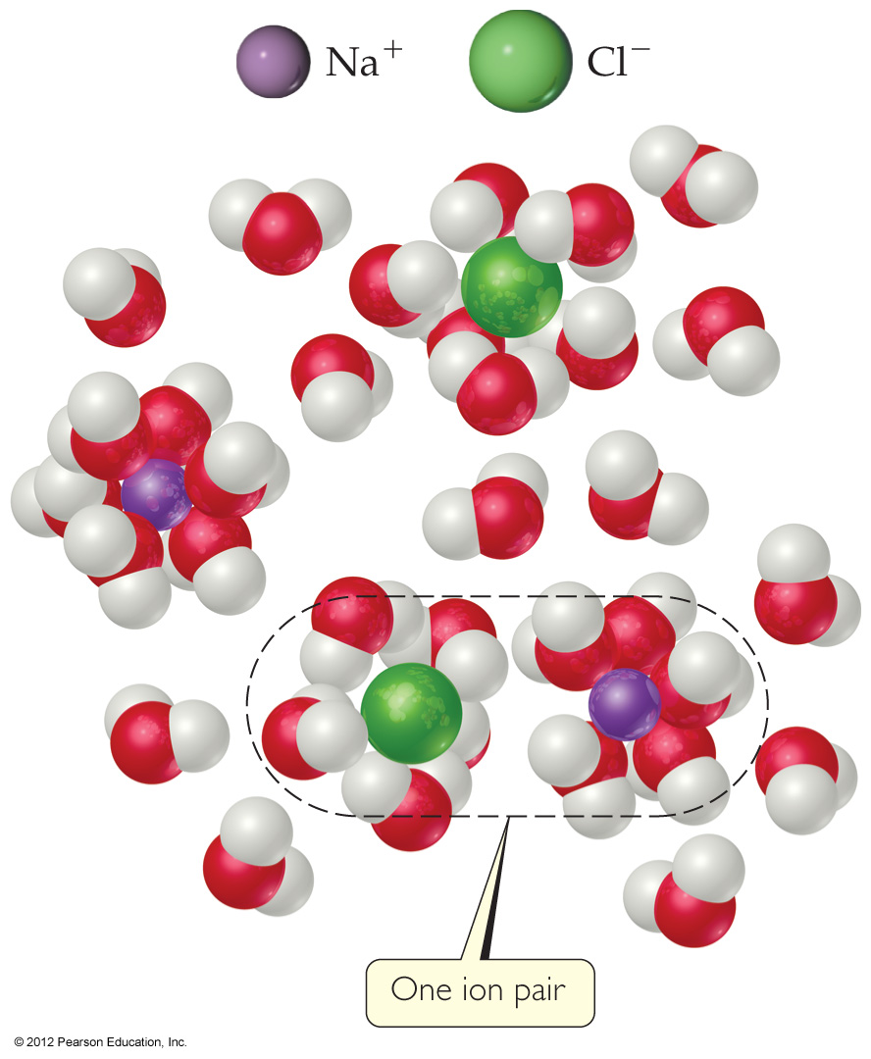
van’t Hoff Factor
One mole of NaCl in water does not really give rise to two moles of ions.
© 2012 Pearson Education, Inc.

Slide 44
van’t Hoff Factor
Some Na⁺ and Cl⁻ reassociate for a short time, so the true concentration of particles is somewhat less than two times the concentration of NaCl.
© 2012 Pearson Education, Inc.

Slide 45
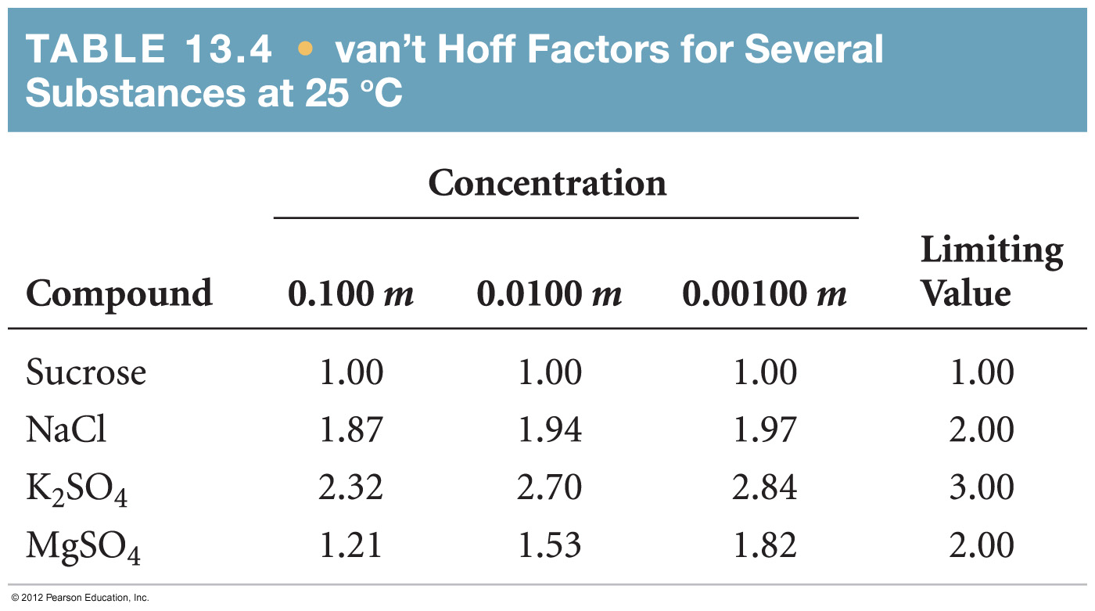
van’t Hoff Factor
Reassociation is more likely at higher concentration.
Therefore, the number of particles present is concentration-dependent.
© 2012 Pearson Education, Inc.

Slide 46
van’t Hoff Factor
We modify the previous equations by multiplying by the van’t Hoff factor, i:
ΔT_{f} = K_{f} • m • i
© 2012 Pearson Education, Inc.

Slide 47
Osmosis
Some substances form semipermeable membranes, allowing some smaller particles to pass through, but blocking other larger particles.
In biological systems, most semipermeable membranes allow water to pass through, but solutes are not free to do so.
© 2012 Pearson Education, Inc.

Slide 48
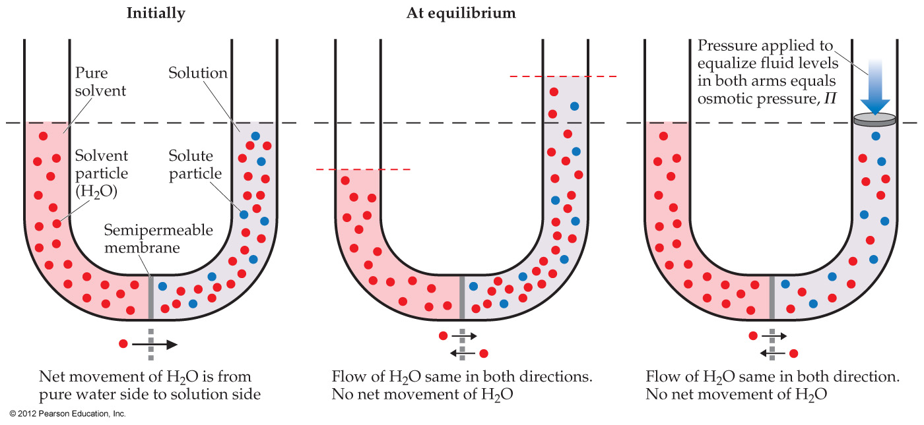
Osmosis
In osmosis, there is net movement of solvent from the area of higher solvent concentration (lower solute concentration) to the area of lower solvent concentration (higher solute concentration).
© 2012 Pearson Education, Inc.

Slide 49
Osmotic Pressure
The pressure required to stop osmosis, known as osmotic pressure, π, is
n
V
π = ( )RT = MRT
where M is the molarity of the solution.
If the osmotic pressure is the same on both sides of a membrane (i.e., the concentrations are the same), the solutions are isotonic.
© 2012 Pearson Education, Inc.

Slide 50
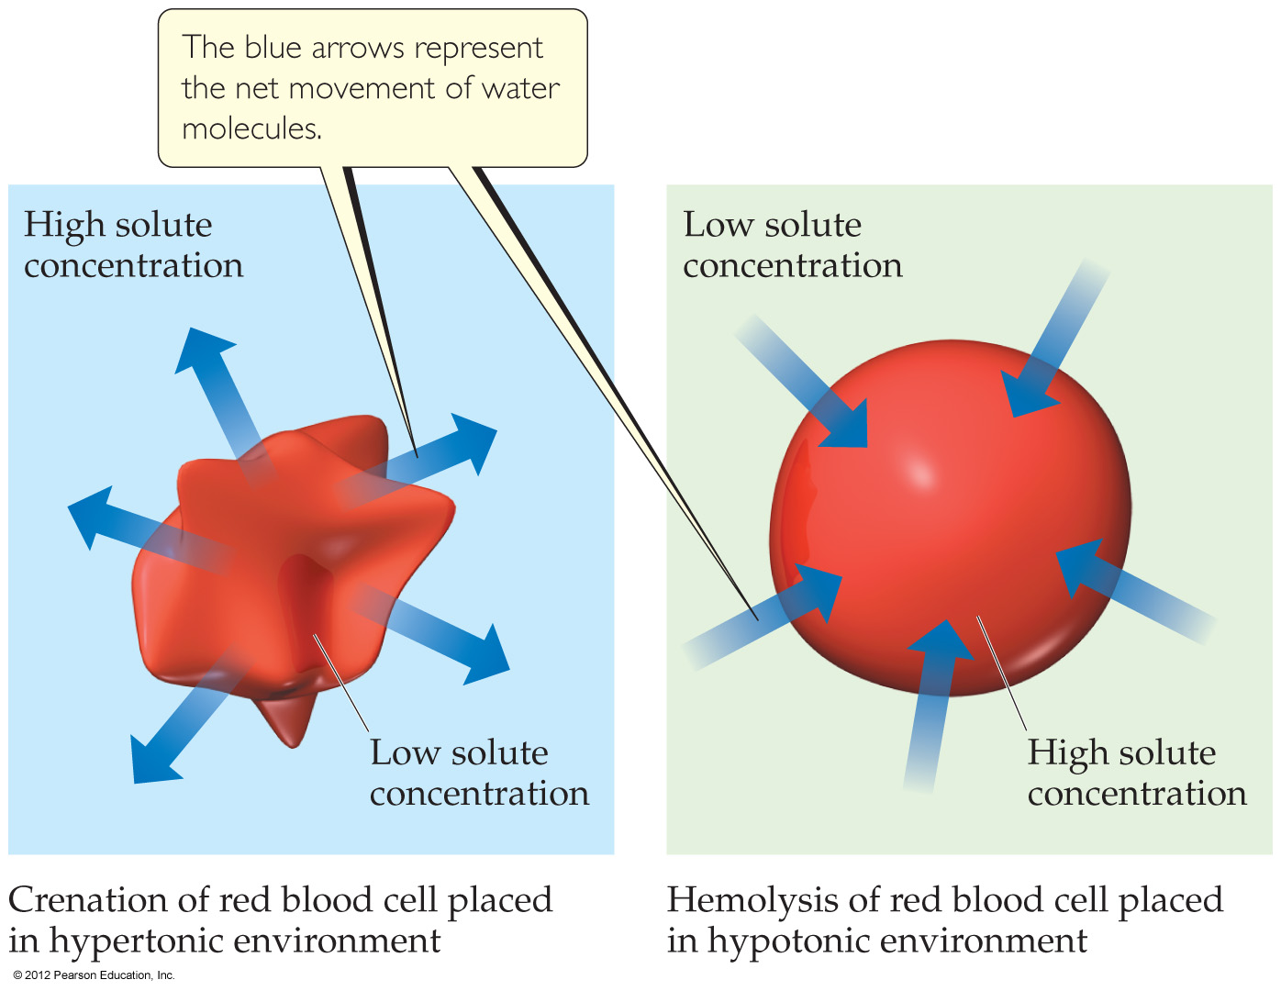
Osmosis in Blood Cells
If the solute concentration outside the cell is greater than that inside the cell, the solution is hypertonic.
Water will flow out of the cell, and crenation results.
© 2012 Pearson Education, Inc.

Slide 51
Osmosis in Cells
If the solute concentration outside the cell is less than that inside the cell, the solution is hypotonic.
Water will flow into the cell, and hemolysis results.
© 2012 Pearson Education, Inc.

Slide 52
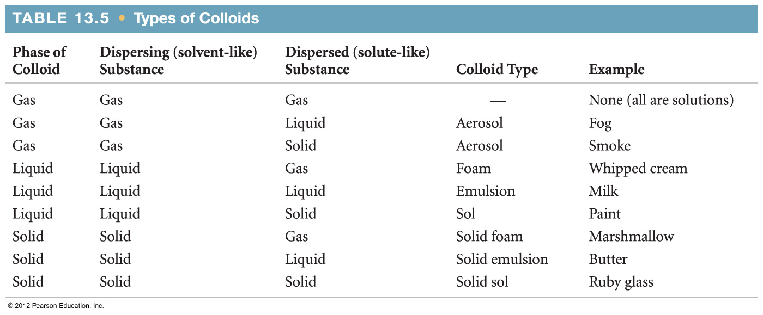
Colloids
Suspensions of particles larger than individual ions or molecules, but too small to be settled out by gravity, are called colloids.
© 2012 Pearson Education, Inc.

Slide 53
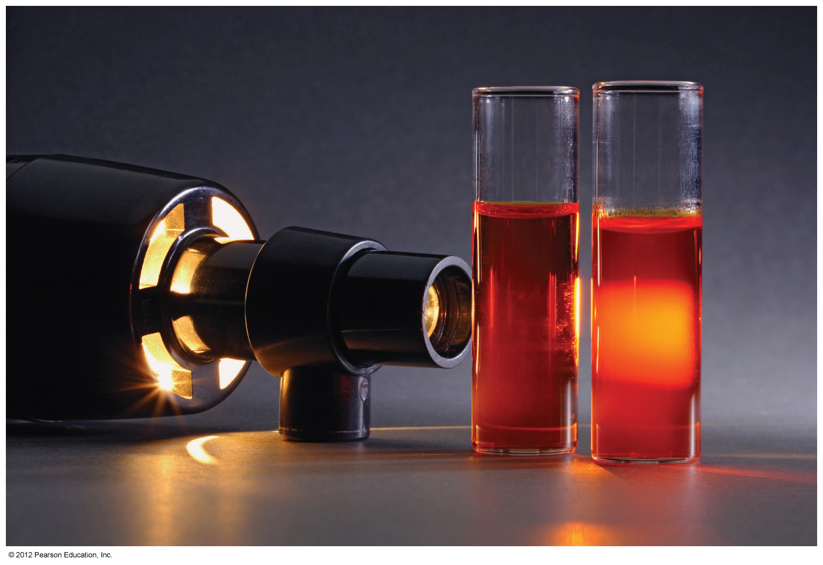

Tyndall Effect
Colloidal suspensions can scatter rays of light.
This phenomenon is known as the Tyndall effect.
© 2012 Pearson Education, Inc.

Slide 54
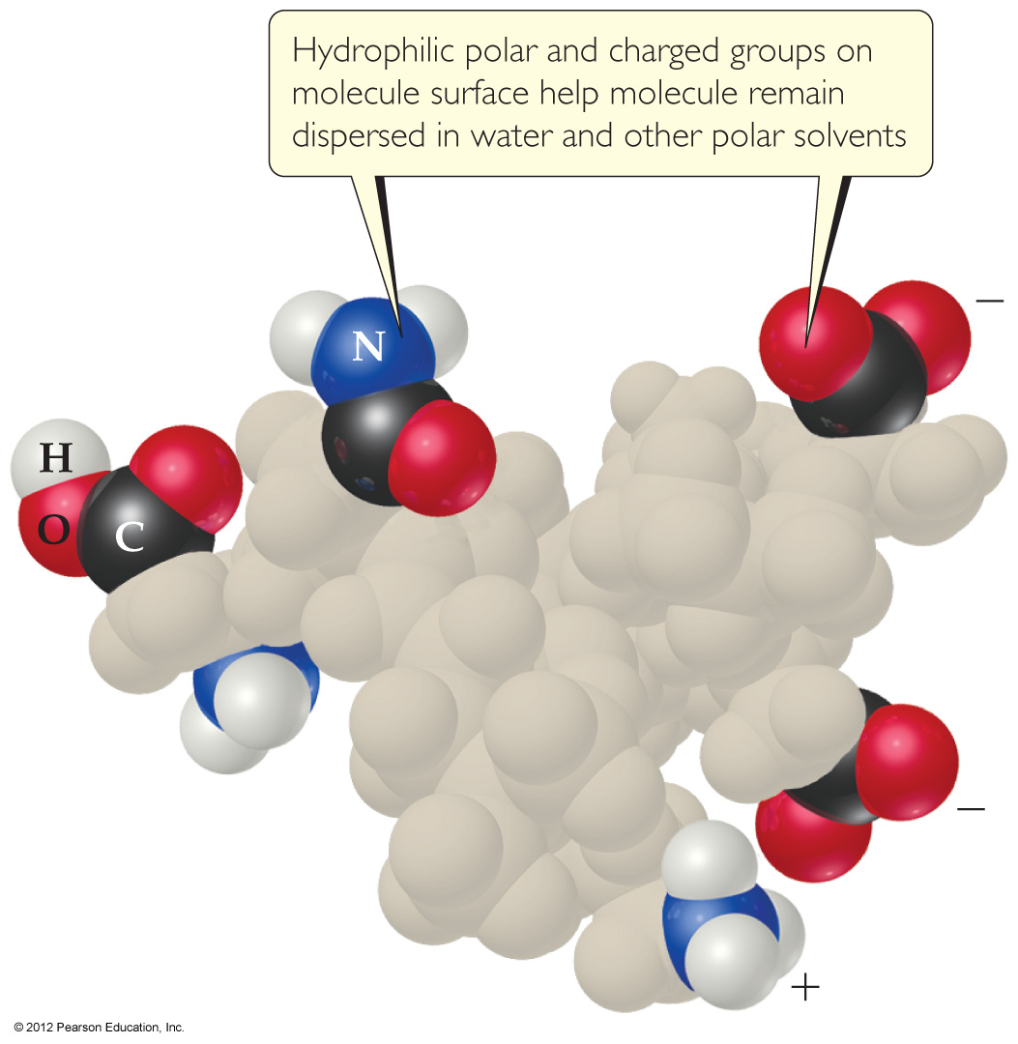
Colloids in Biological Systems
Some molecules have a polar, hydrophilic (water-loving) end and a nonpolar, hydrophobic (water-hating) end.
© 2012 Pearson Education, Inc.

Slide 55
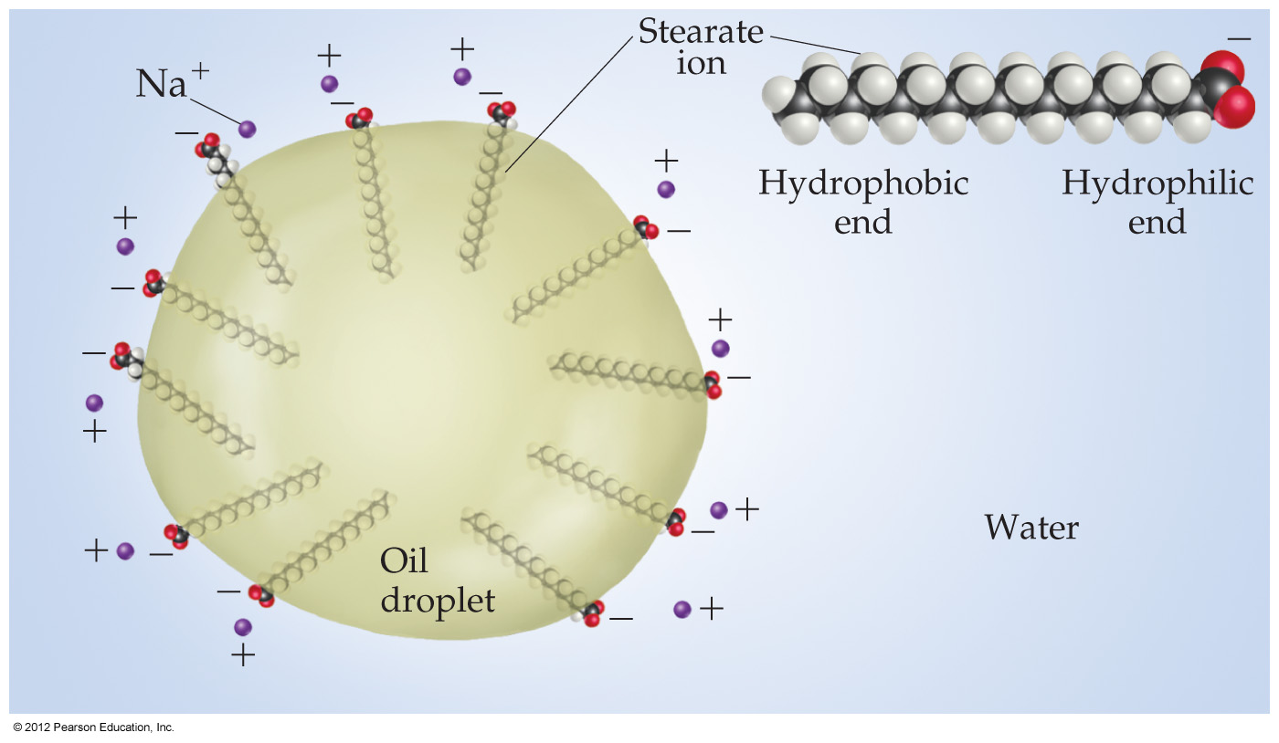
Colloids in Biological Systems
These molecules can aid in the emulsification of fats and oils in aqueous solutions.
© 2012 Pearson Education, Inc.

